Slide 1
Soup to Nuts: LCS Administration for Upgrade

Slide 2

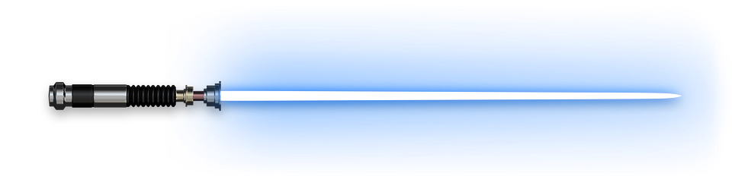
Nathan Clouse
www.atomicax.com
@NathanClouseAX
Technical Solution Architect Dynamic Consulting
AXUG Summit Track Leader 2018/19/20
Nathan.clouse@dynamicconsulting.com

Slide 3

Topics
The Upgrade Experience
New Requirements
On Premise; The way of the Sith
Cloud; The way of the Jedi
What’s Different
Managed Updates
Code Upgrade
Upgrade Analysis
Subscription Estimator
Onboarding
Asset Library
Project Settings
Work Items
Environments
Topologies and Tiers
Azure & Environments
Development
Management
Tools
BPM
Servicing
Analytics
Diagnostics
Environment Monitoring

Slide 4
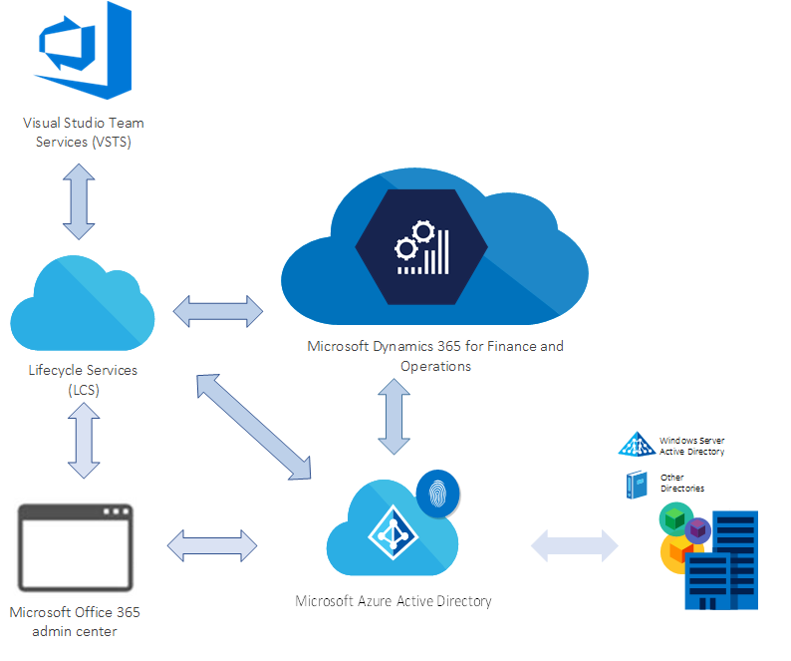
Overall Solution for D365FO
Notes:
Subscription
Licenses
Tenant, AAD
Azure DevOps
LCS is a collaboration portal that provides an environment and a set of regularly updated services that can help you manage the application lifecycle of your implementations. For more information, see Lifecycle Services resources. After you purchase and activate a subscription for a Finance and Operations app, an Implementation project workspace is provisioned in LCS when the tenant administrator signs in for the first time.

Slide 5

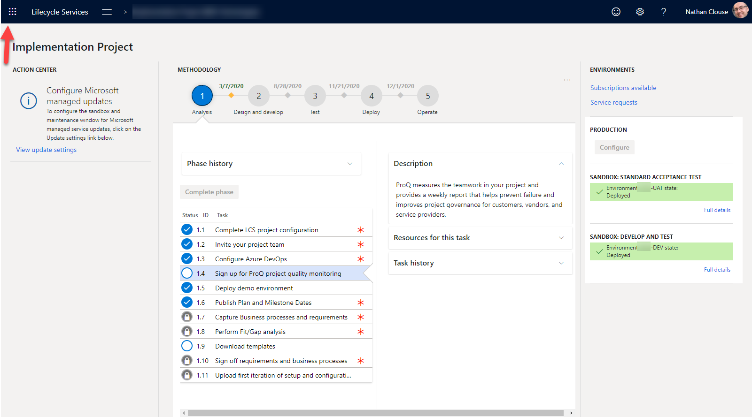
Waffle

Slide 6
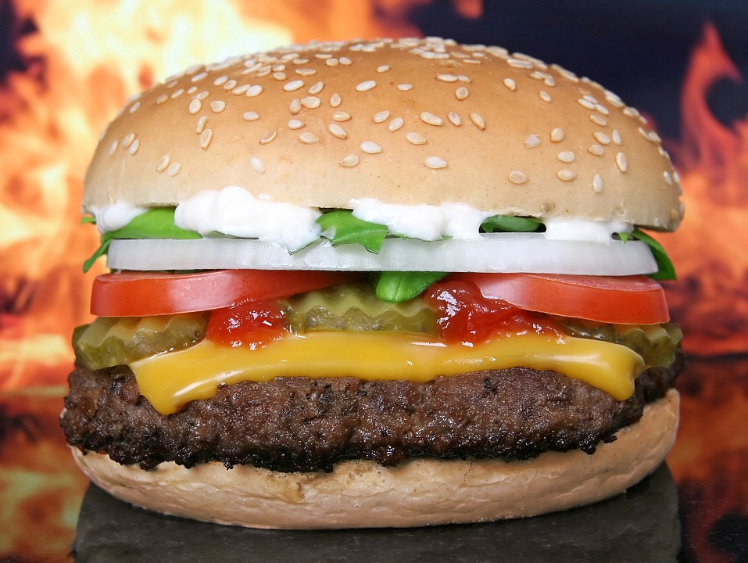
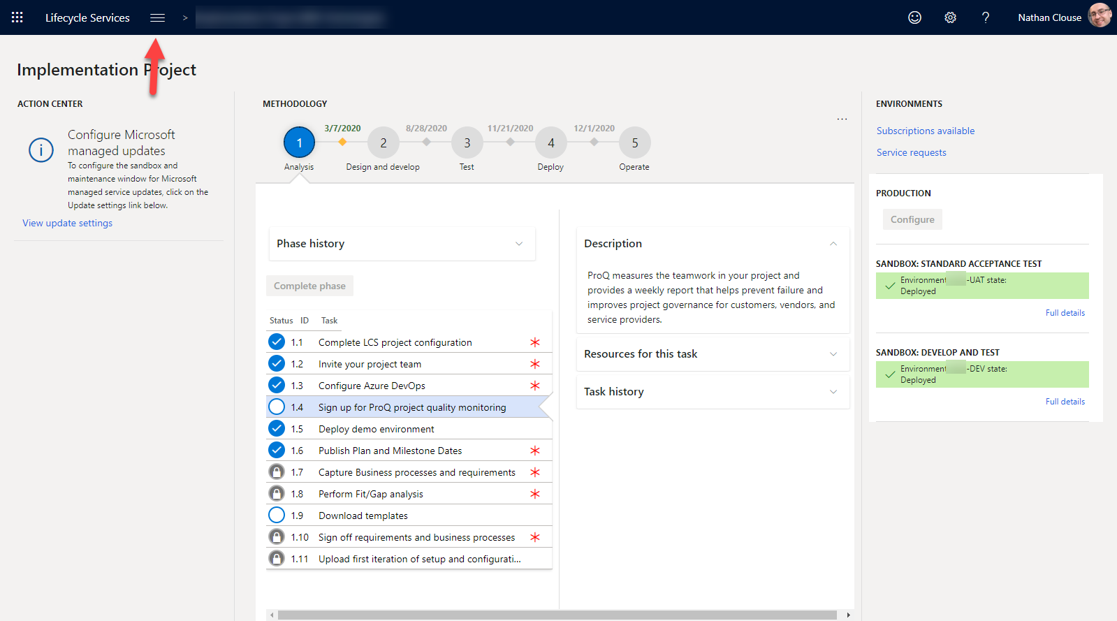
Hamburger
Notes:
ADMIRAL RADDUS AND ADMIRAL ACKBAR BOTH HAIL FROM WHICH PLANET? mon cala

Slide 7
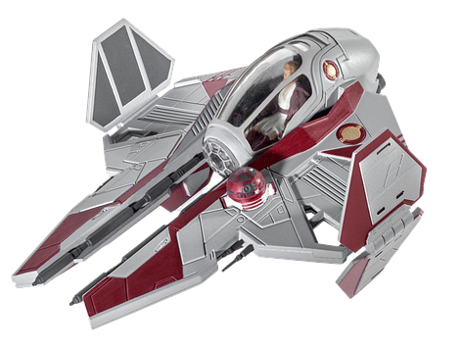
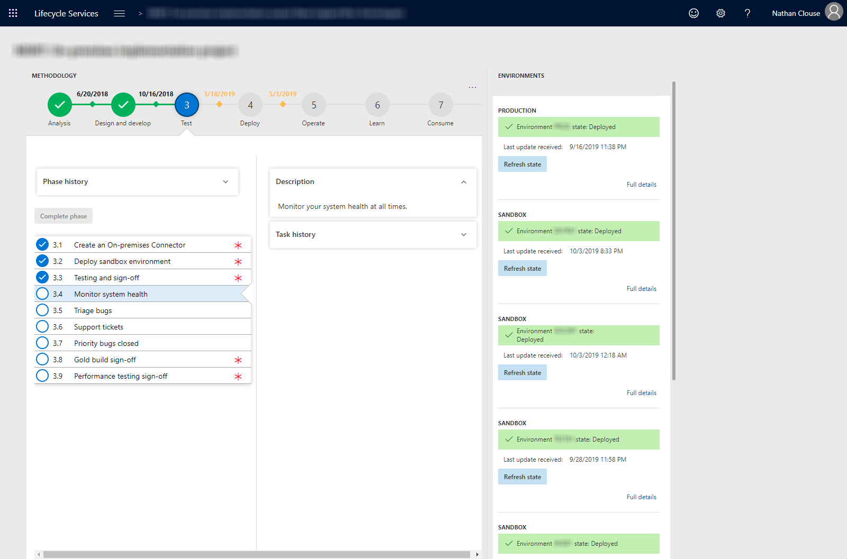
LCS Look and Feel – On Premise
Notes:
LCS look for on prem

Slide 8
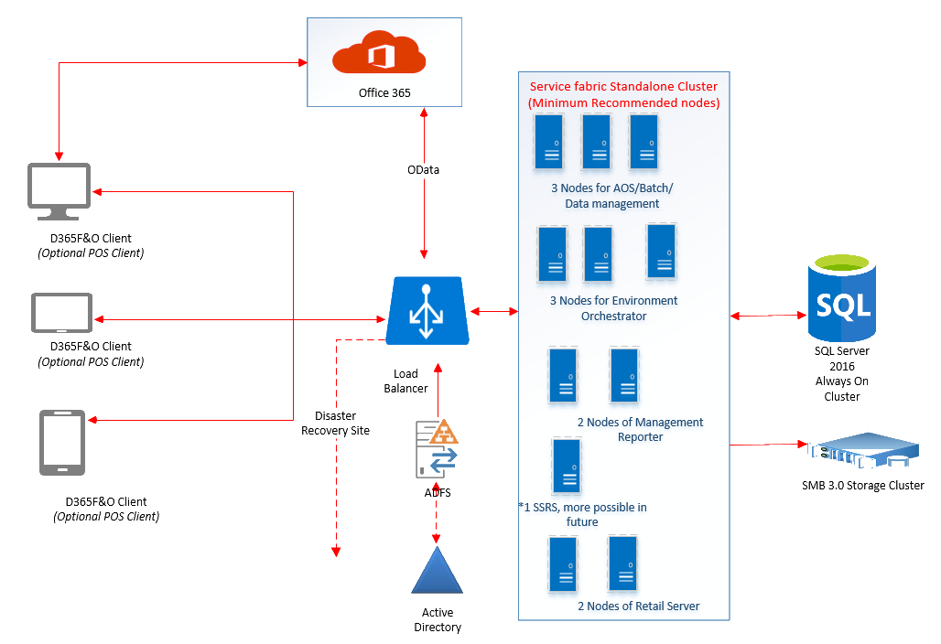
Sample On Premise Architecture
Notes:
Lots of time and hardware
expensive

Slide 9
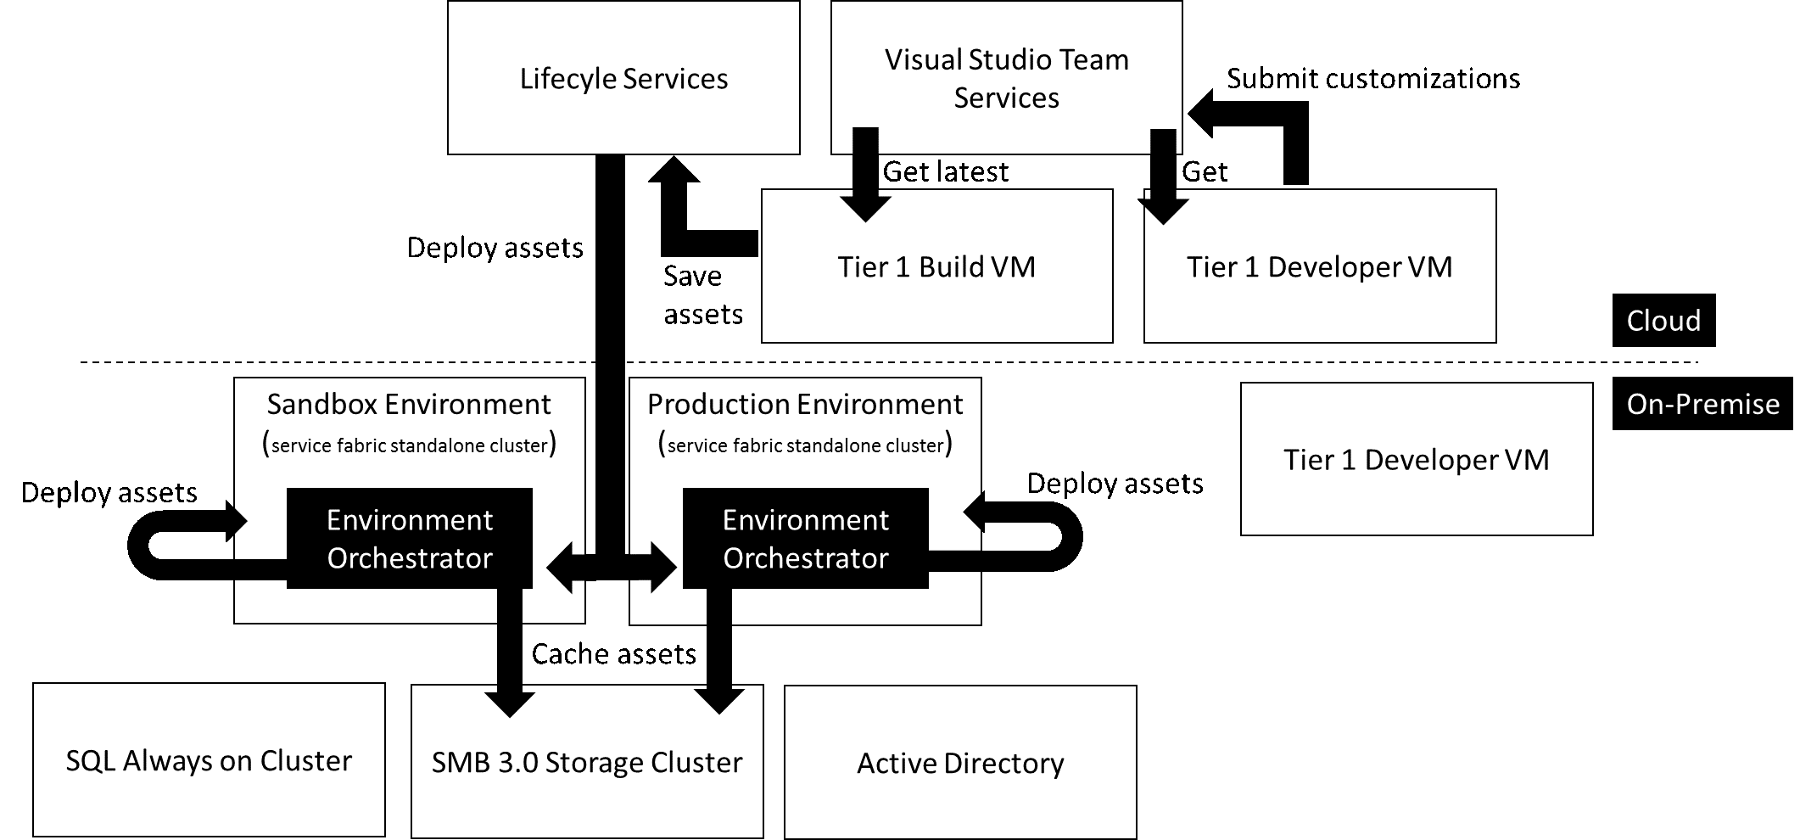

Slide 10
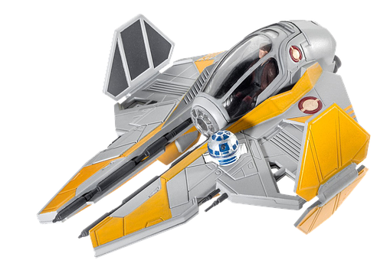
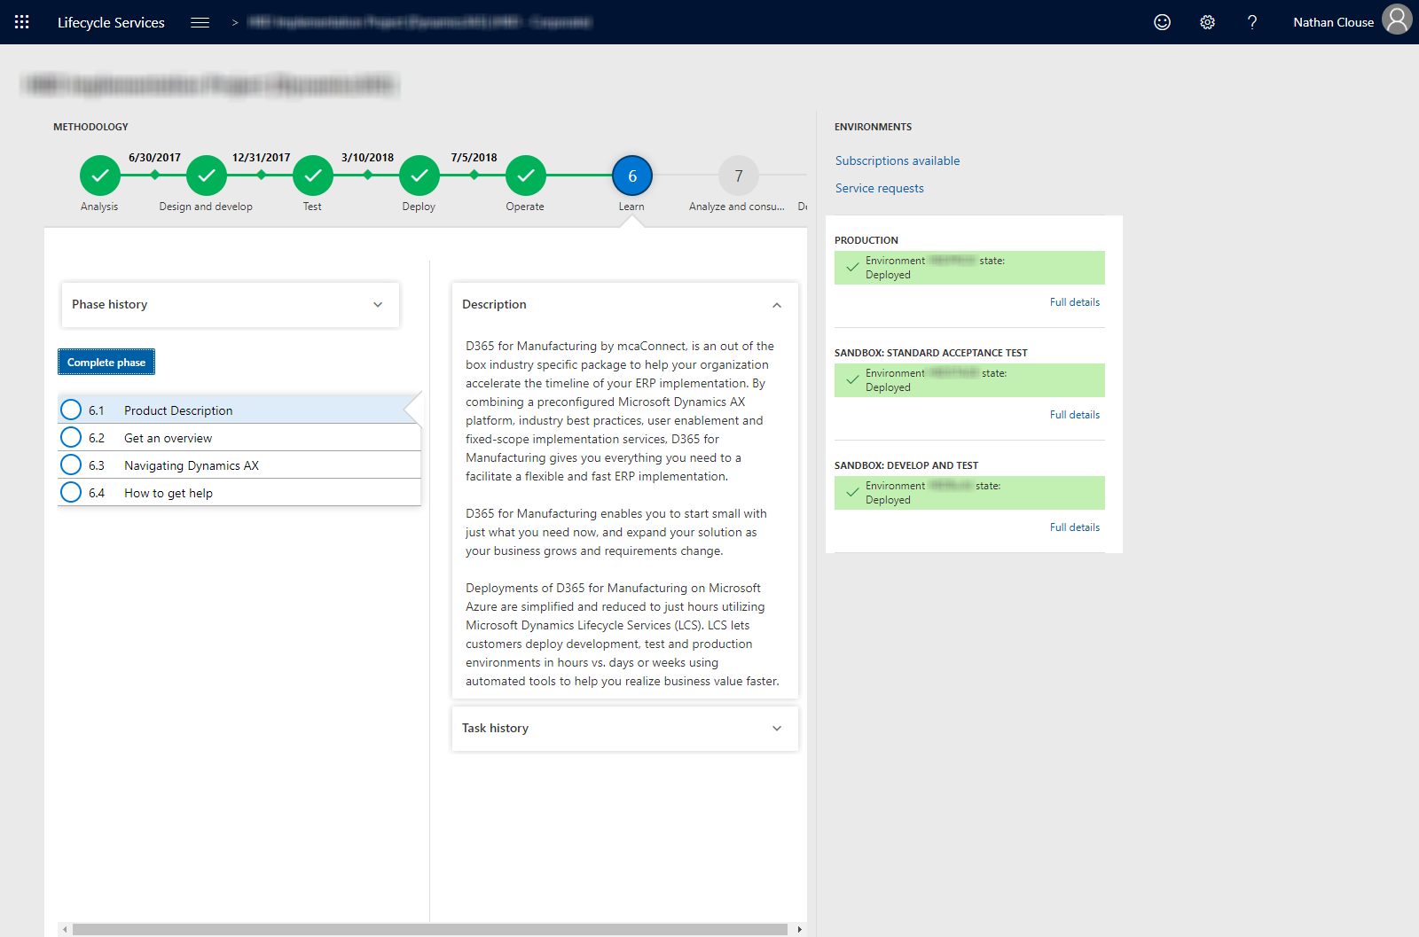
LCS Look and Feel - Cloud
Notes:
What LCS looks like for the cloud

Slide 11

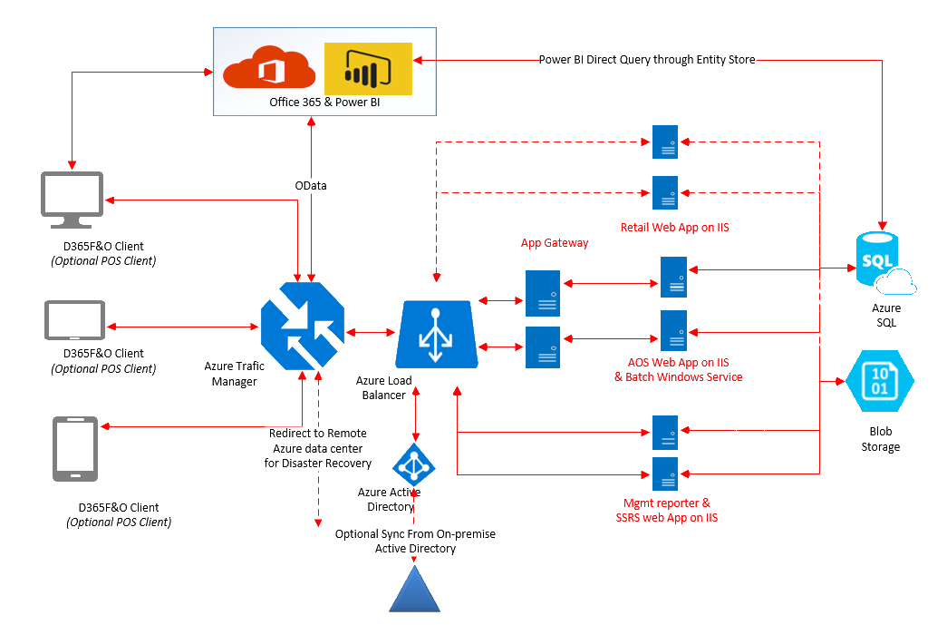
Cloud Architecture (Old)

Slide 12
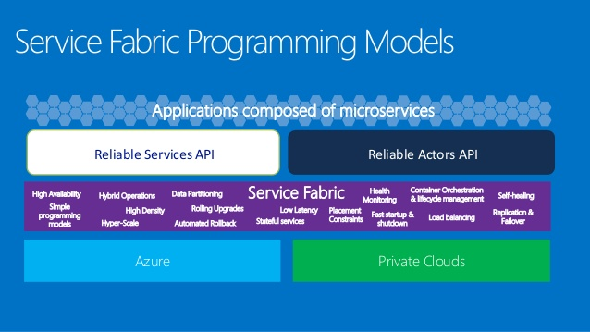
Cloud Architecture (New)

Slide 13
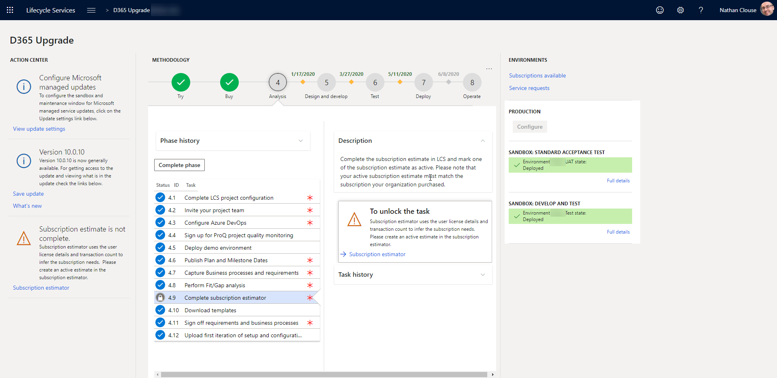
What’s Different
Notes:
This is LCS project home screen
Action center on left, environments and quick links on the right
Main project methodology and time line in the center

Slide 14
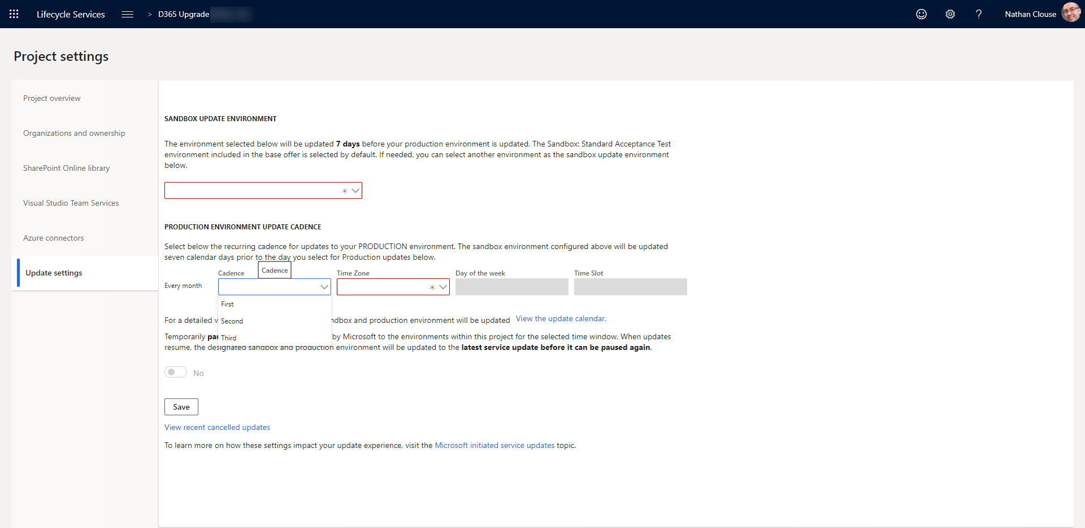
Scheduled Update
Notes:
You pick the schedule
Skip updates up to 2 times if needed

Slide 15
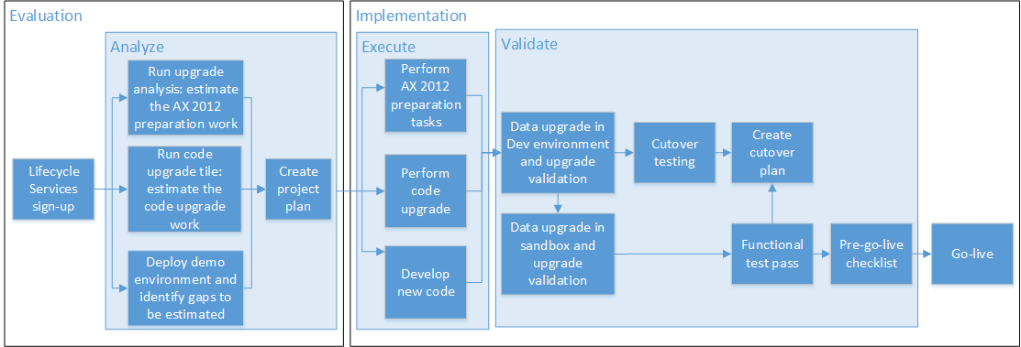
Upgrade Tools

Slide 16
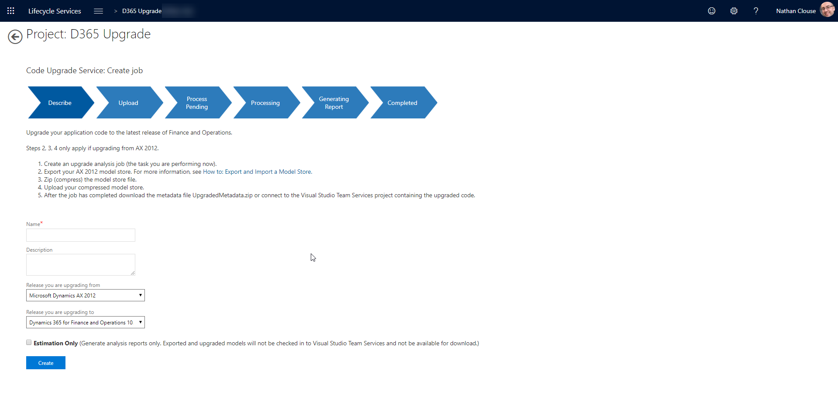
Code Upgrade
Notes:
Create an upgrade analysis job (the task you are performing now).
Export your AX 2012 model store. For more information, see How to: Export and Import a Model Store.
Zip (compress) the model store file.
Upload your compressed model store.
After the job has completed download the metadata file UpgradedMetadata.zip or connect to the Visual Studio Team Services project containing the upgraded code.

Slide 17
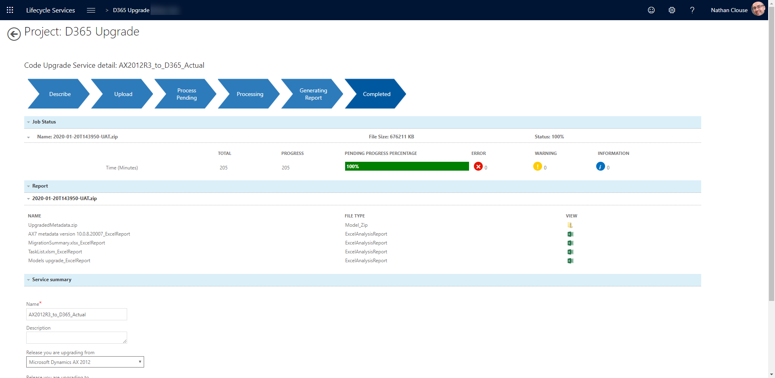
Code Upgrade (cont.)

Slide 18
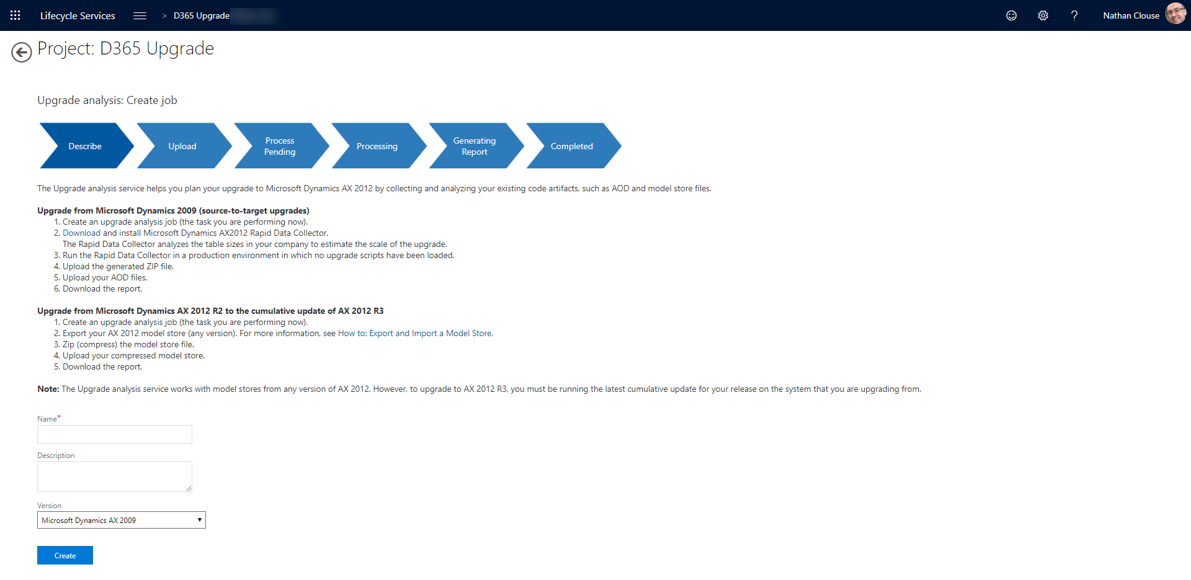
Upgrade Analysis
Notes:
Upgrade from Microsoft Dynamics 2009 (source-to-target upgrades)
Create an upgrade analysis job (the task you are performing now).
Download and install Microsoft Dynamics AX2012 Rapid Data Collector. The Rapid Data Collector analyzes the table sizes in your company to estimate the scale of the upgrade.
Run the Rapid Data Collector in a production environment in which no upgrade scripts have been loaded.
Upload the generated ZIP file.
Upload your AOD files.
Download the report.
Upgrade from Microsoft Dynamics AX 2012 R2 to the cumulative update of AX 2012 R3
Create an upgrade analysis job (the task you are performing now).
Export your AX 2012 model store (any version). For more information, see How to: Export and Import a Model Store.
Zip (compress) the model store file.
Upload your compressed model store.
Download the report.

Slide 19
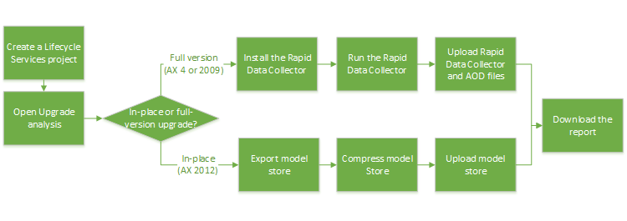
Upgrade Analysis
Notes:
Similar to code upgrade
Helps plan your upgrade by collecting and analyzing 2012 code artifacts
Just a report

Slide 20
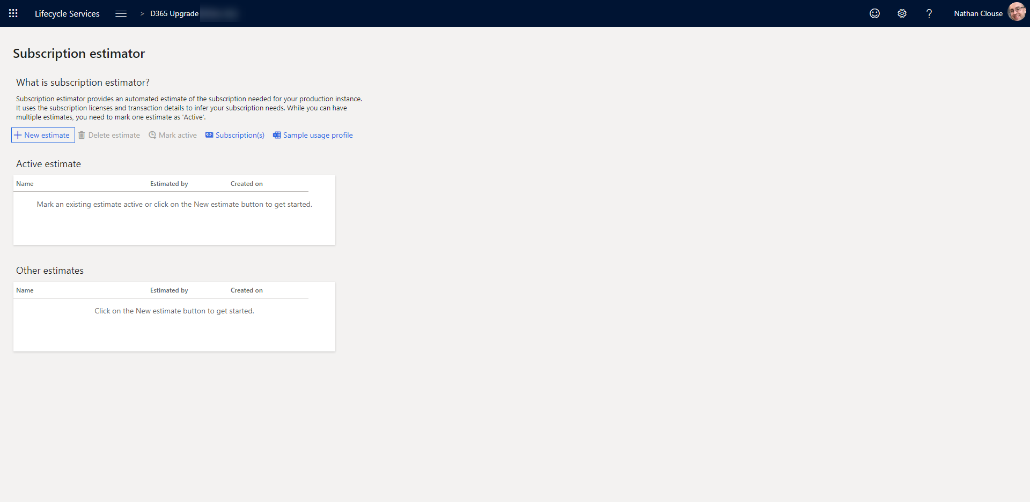
Subscription Estimator

Slide 21
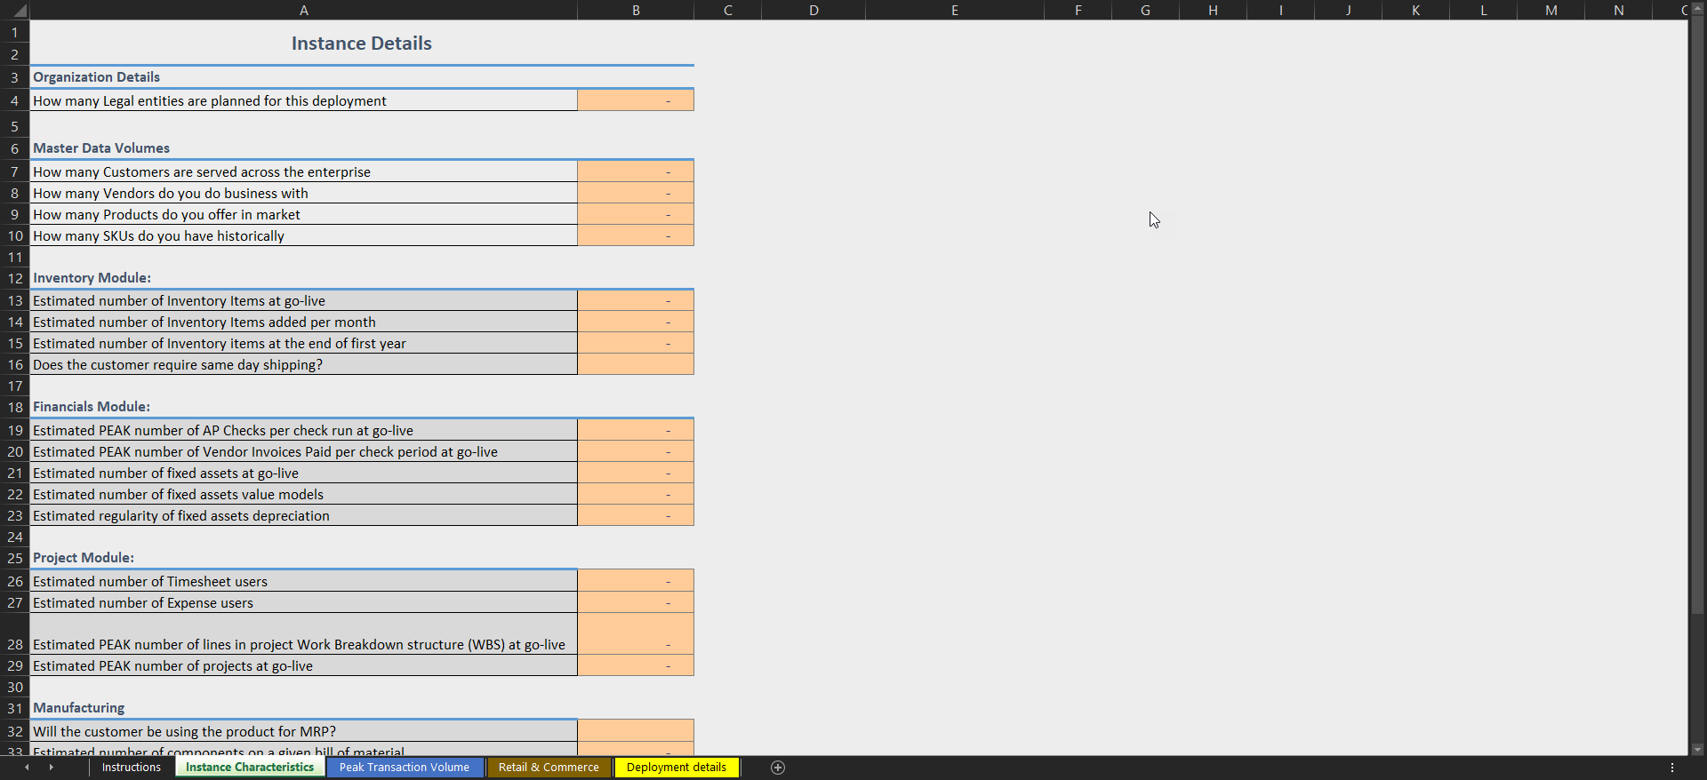
Subscription Estimator

Slide 22
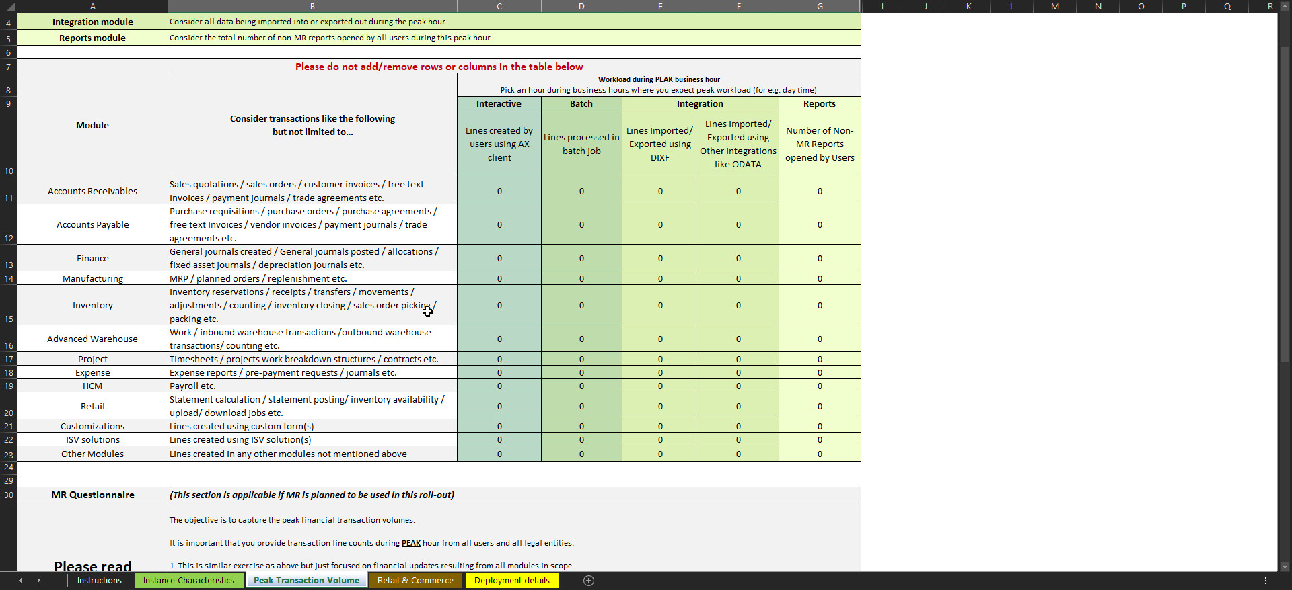
Subscription Estimator

Slide 23
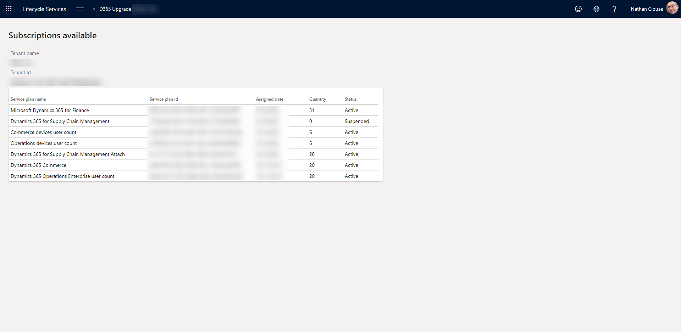
Subscriptions

Slide 24
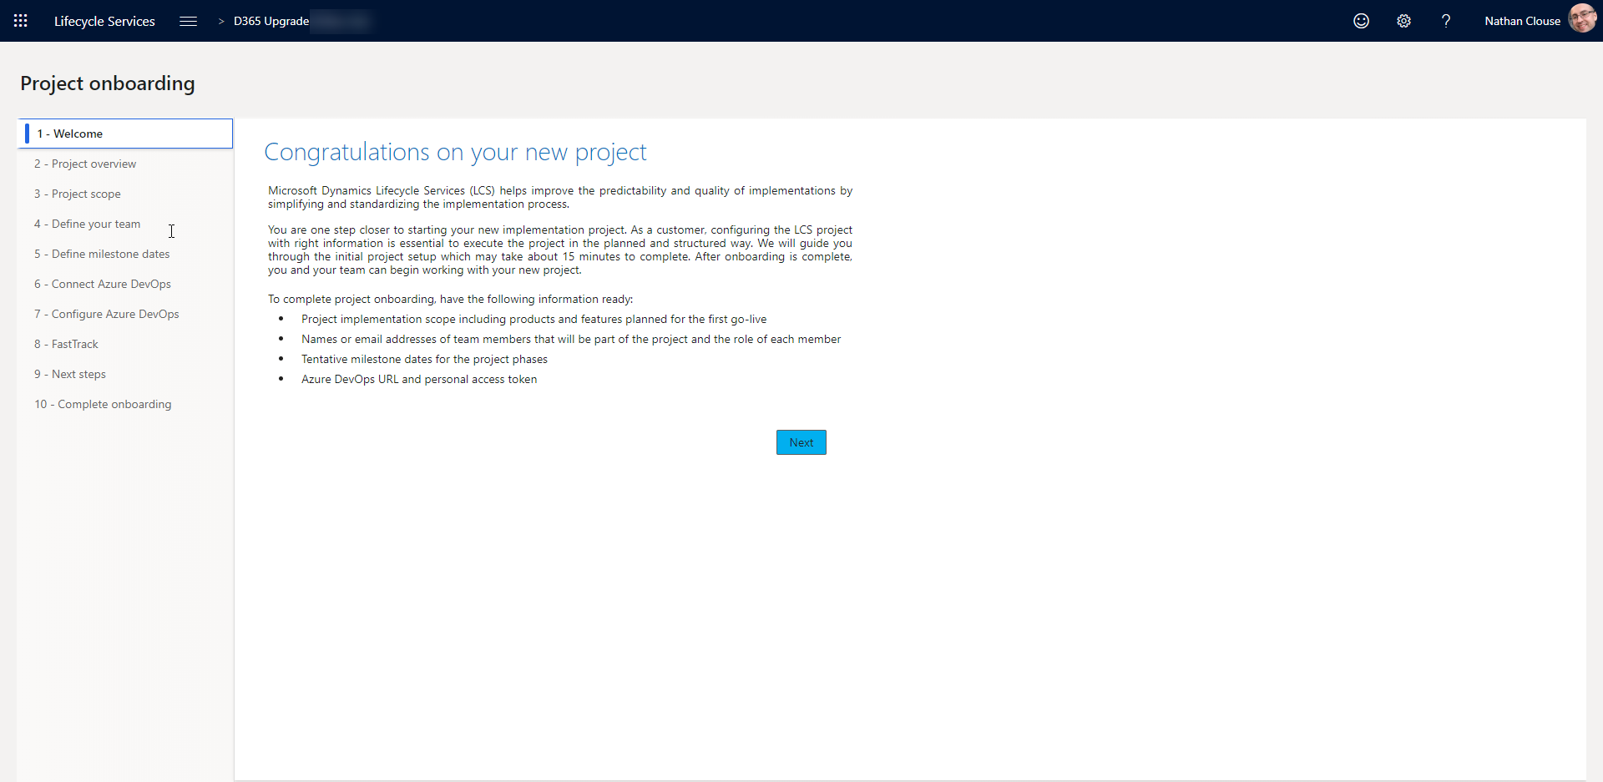
Onboarding

Slide 25
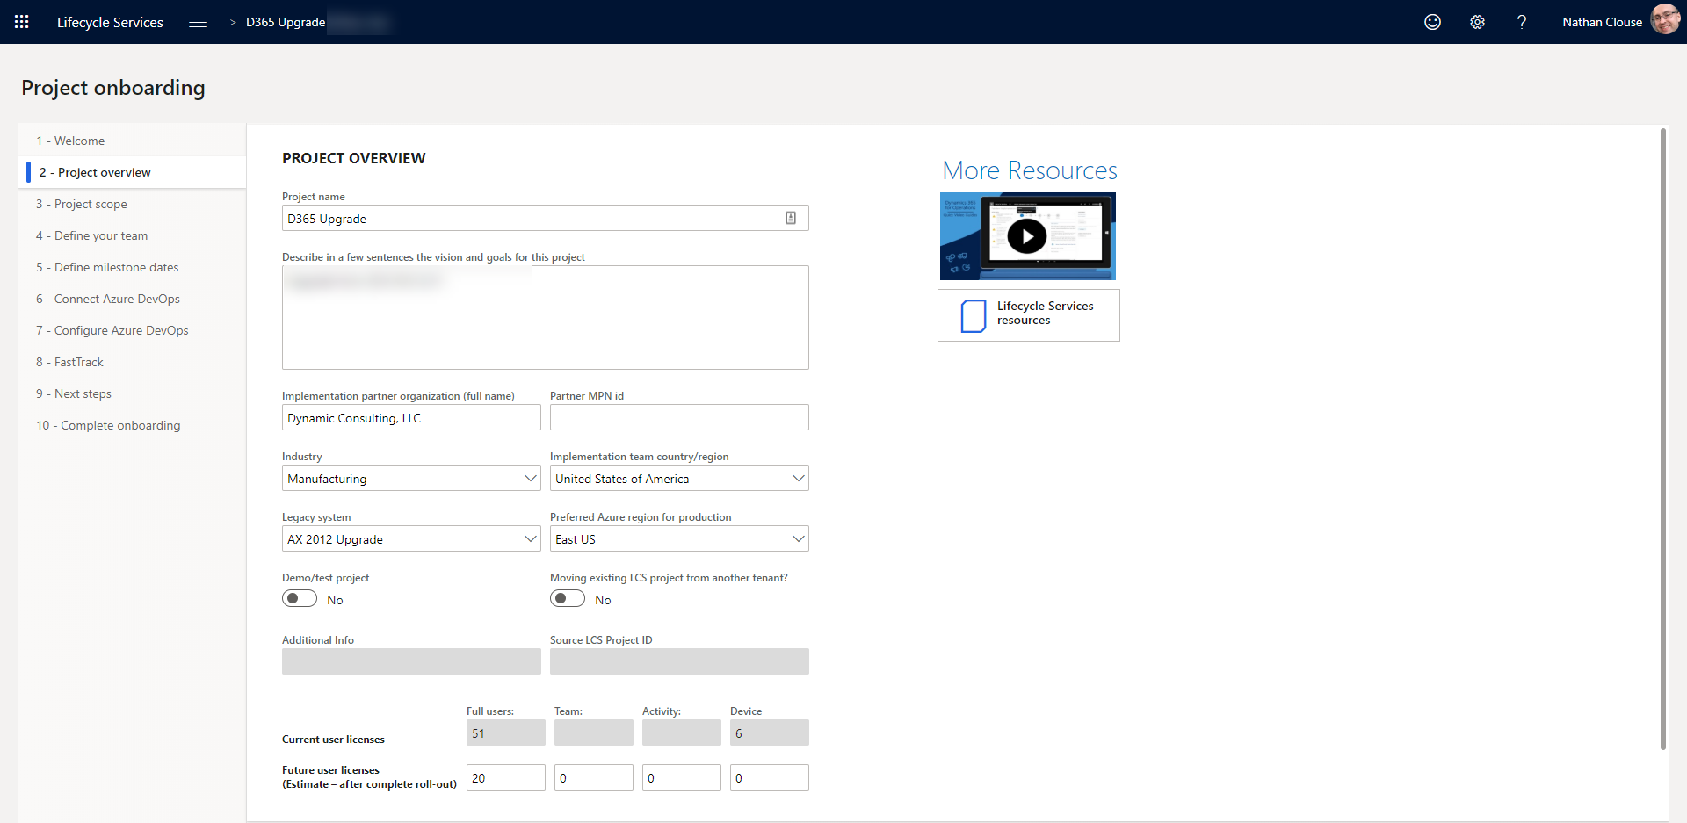
Onboarding (cont.)

Slide 26
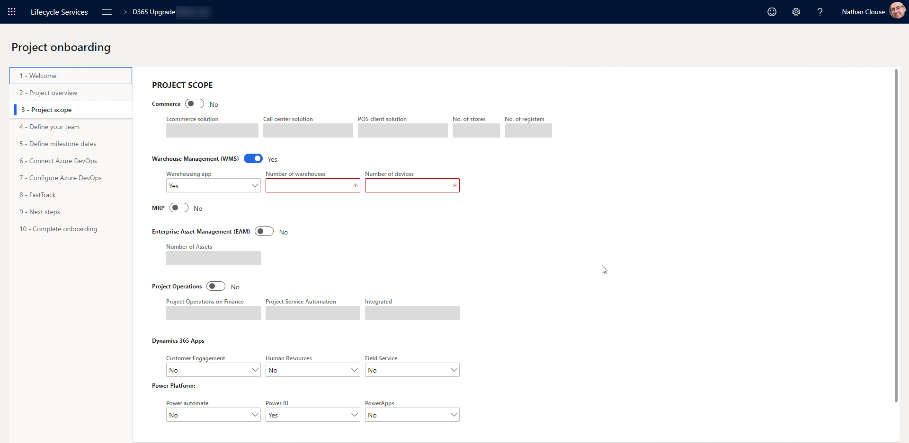
Onboarding (cont.)

Slide 27
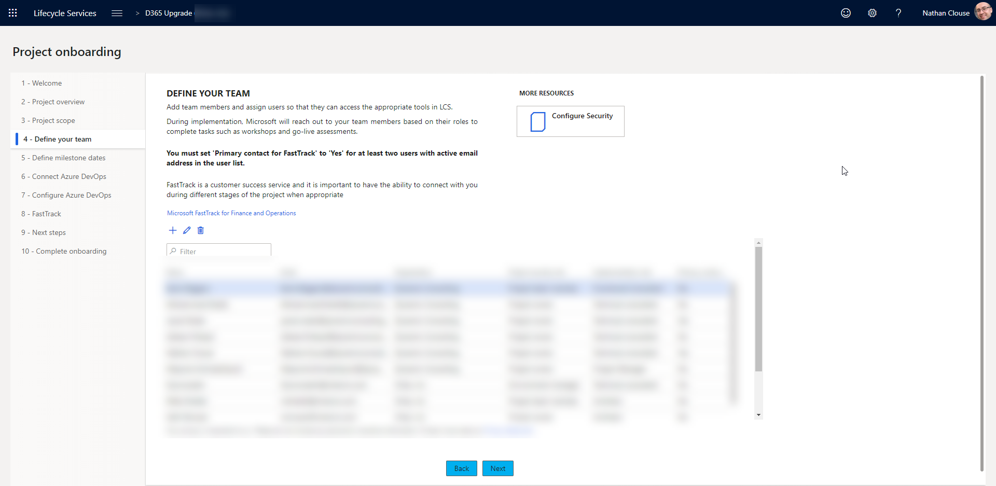
Onboarding (cont.)

Slide 28
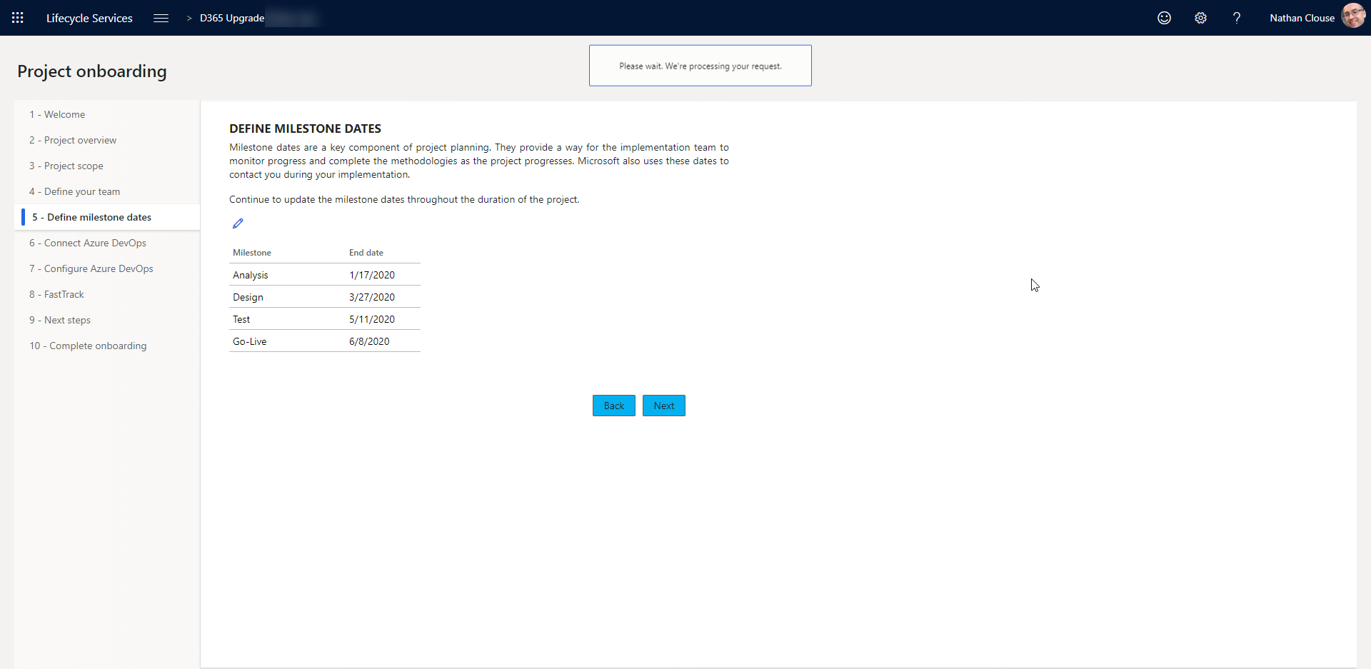
Onboarding (cont.)

Slide 29
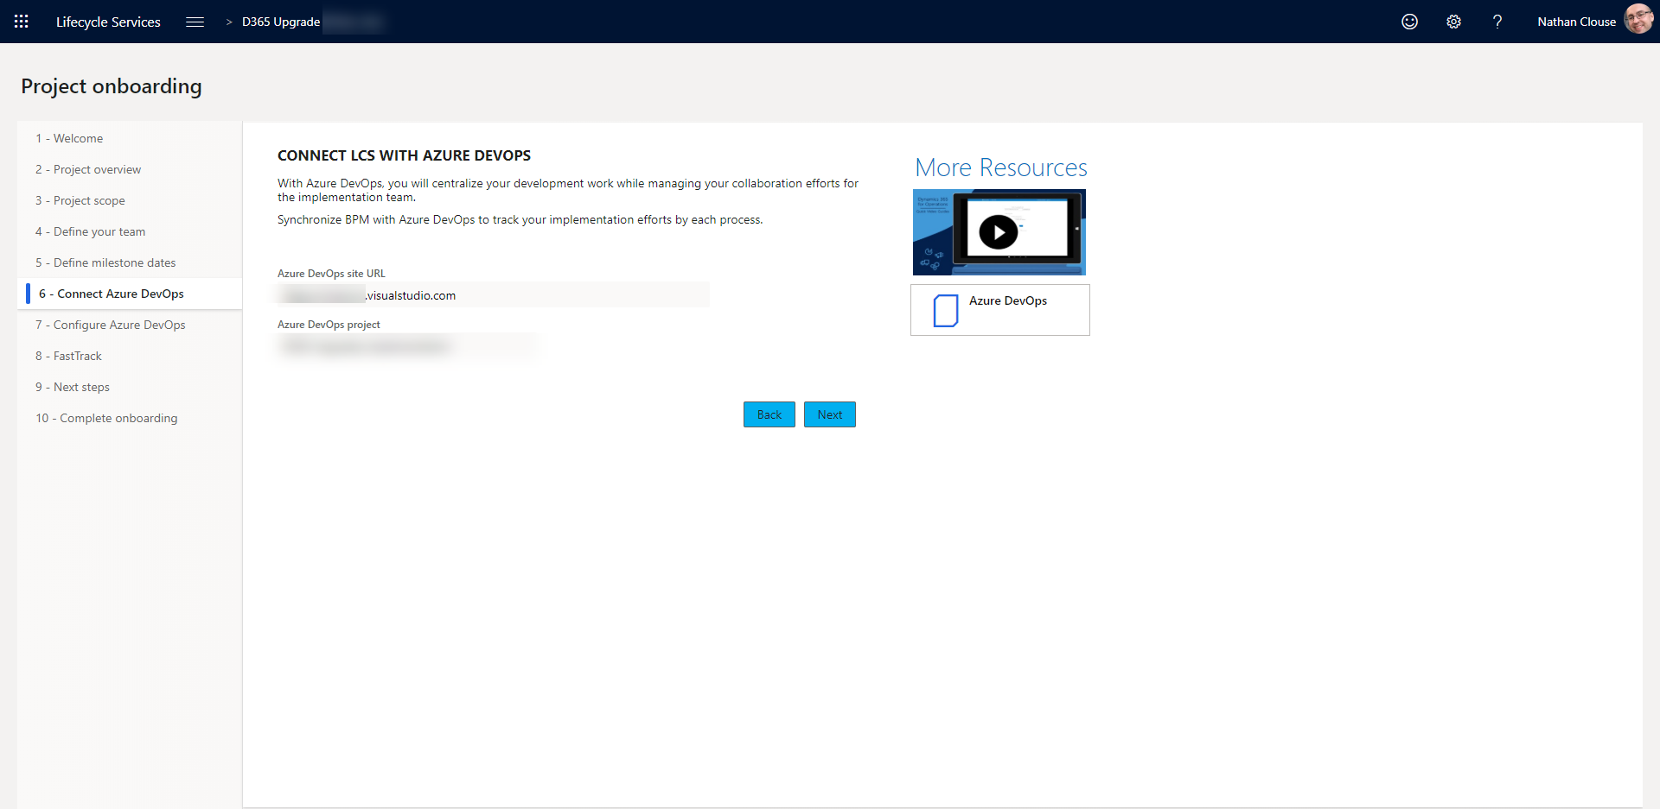
Onboarding (cont.)

Slide 30
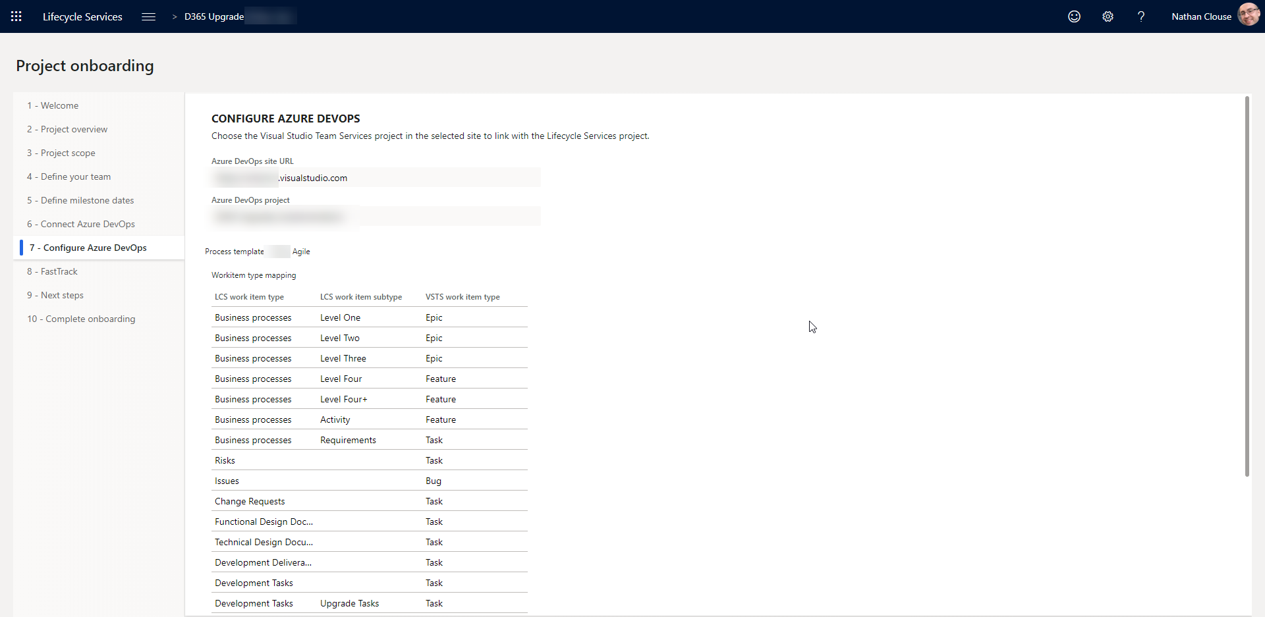
Onboarding (cont.)

Slide 31
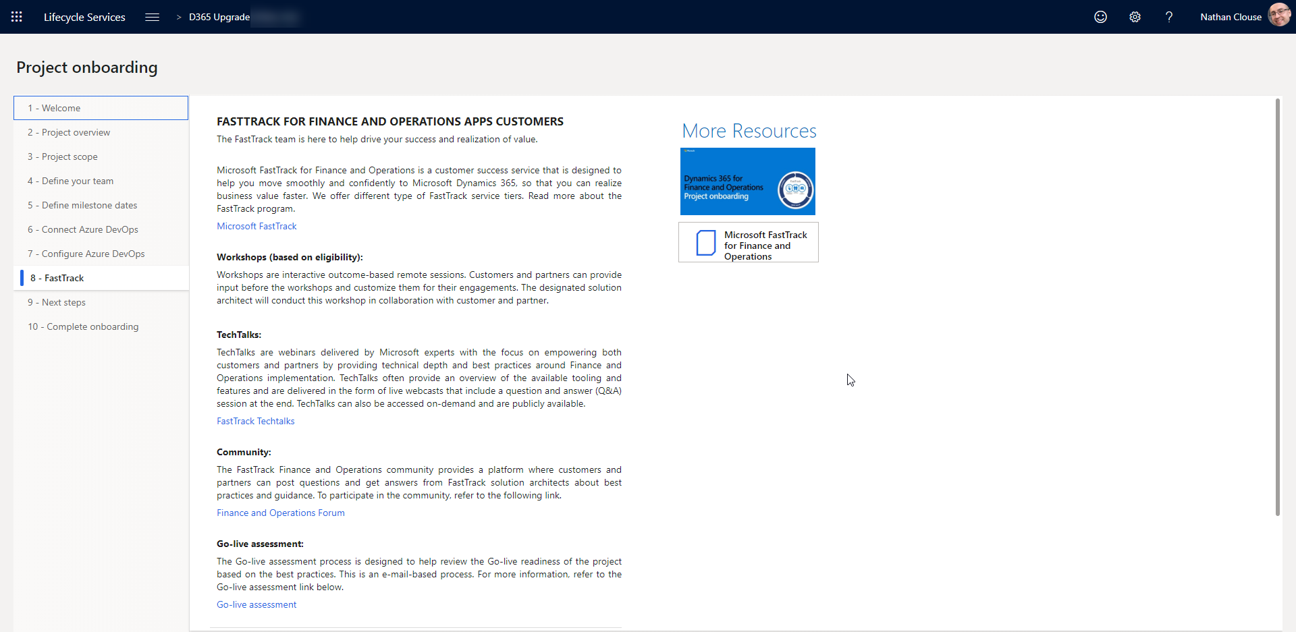
Onboarding (cont.)

Slide 32
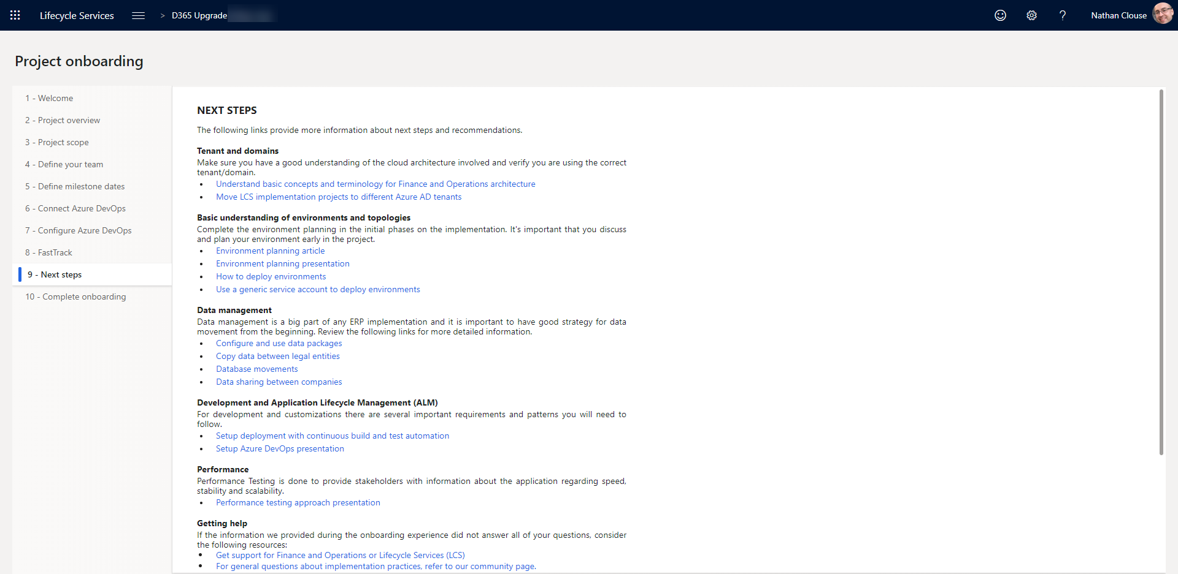
Onboarding (cont.)

Slide 33
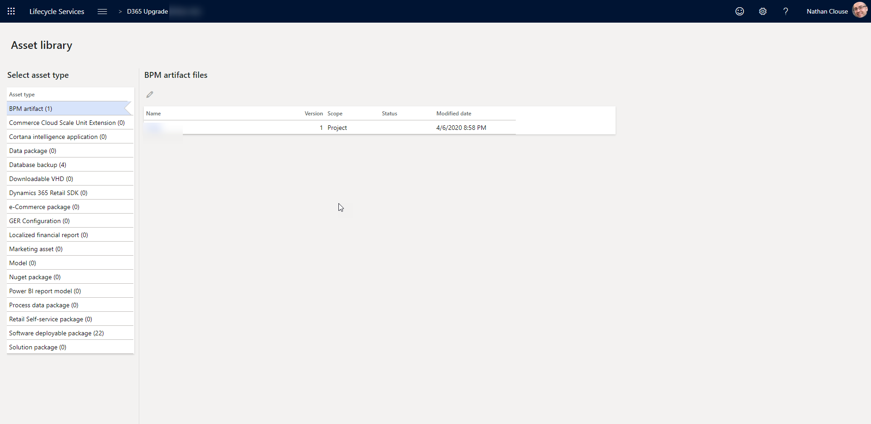
Asset Library

Slide 34
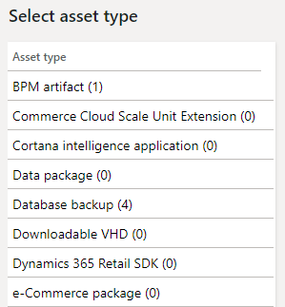
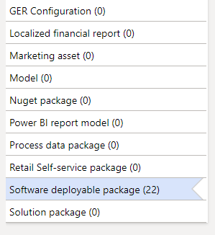
Asset Library (cont.)

Slide 35
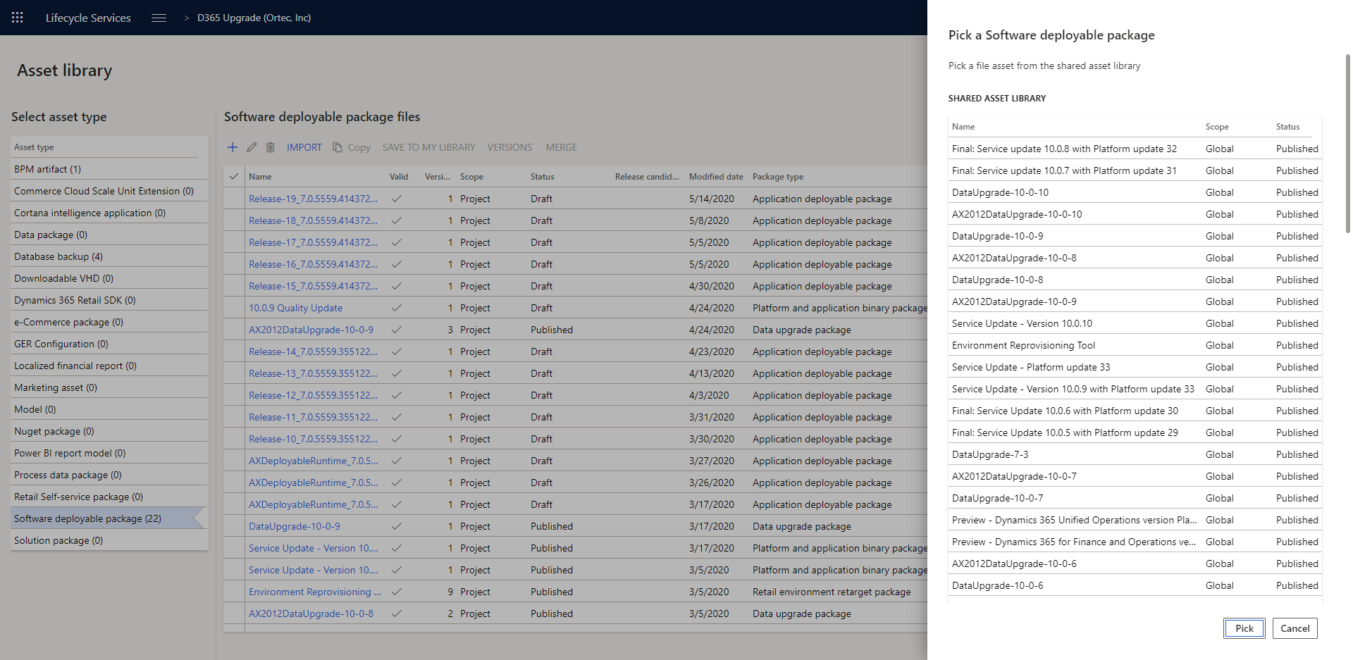
Asset Library (cont.)

Slide 36
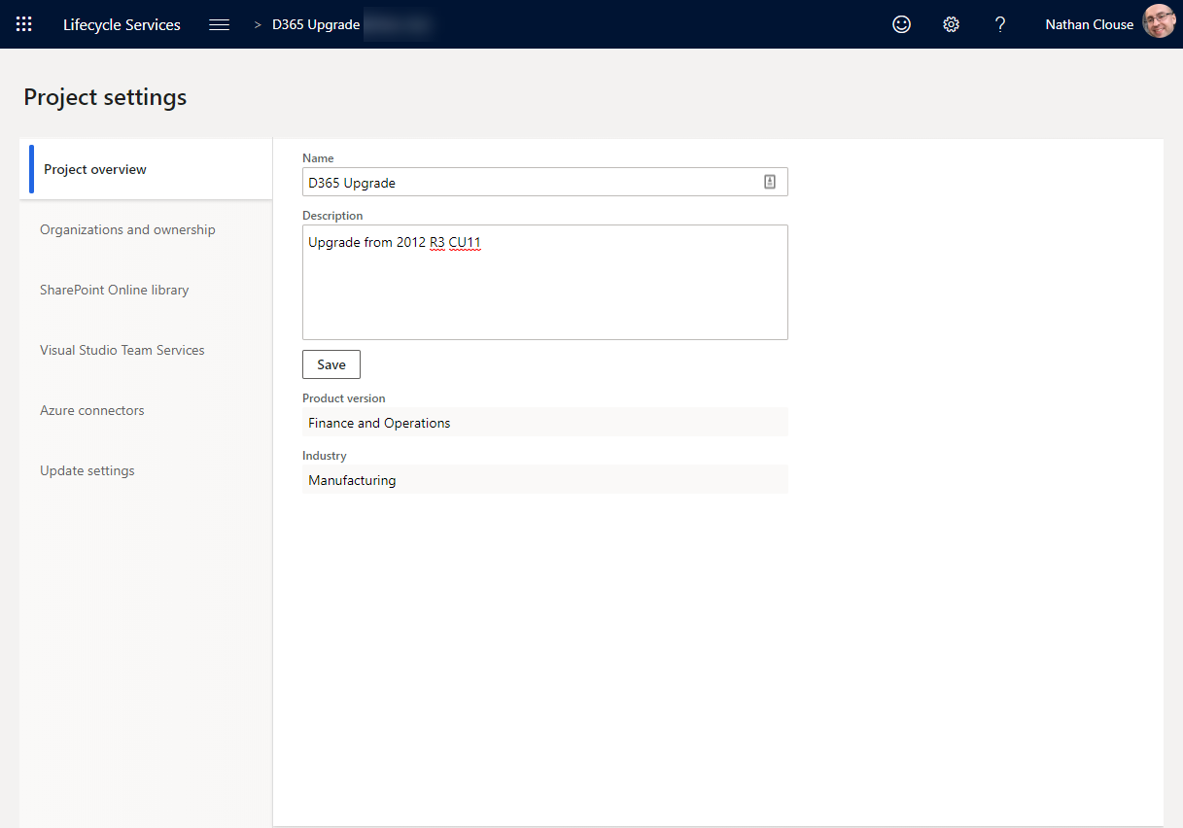
Project Settings

Slide 37
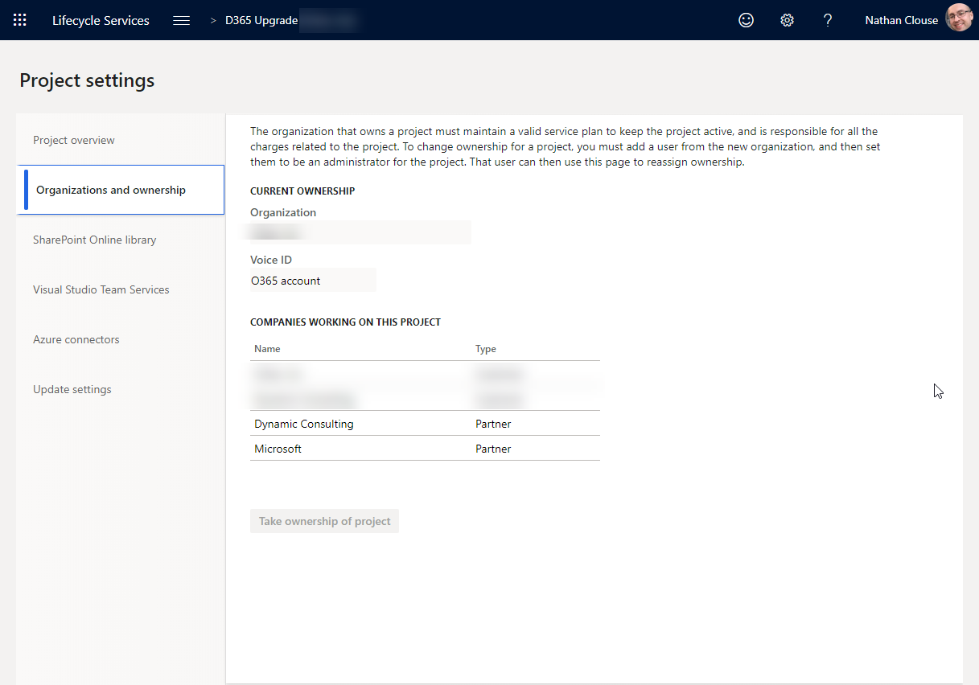
Project Settings - Organizations

Slide 38
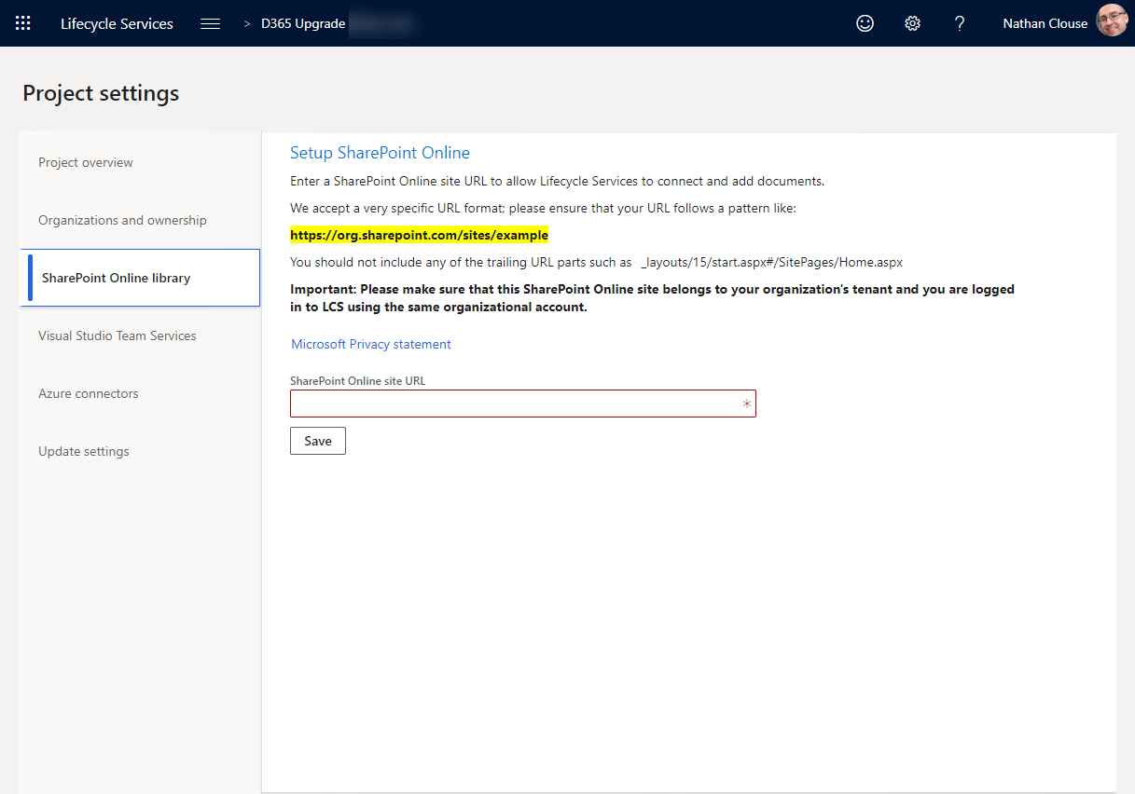
Project Settings - SharePoint

Slide 39
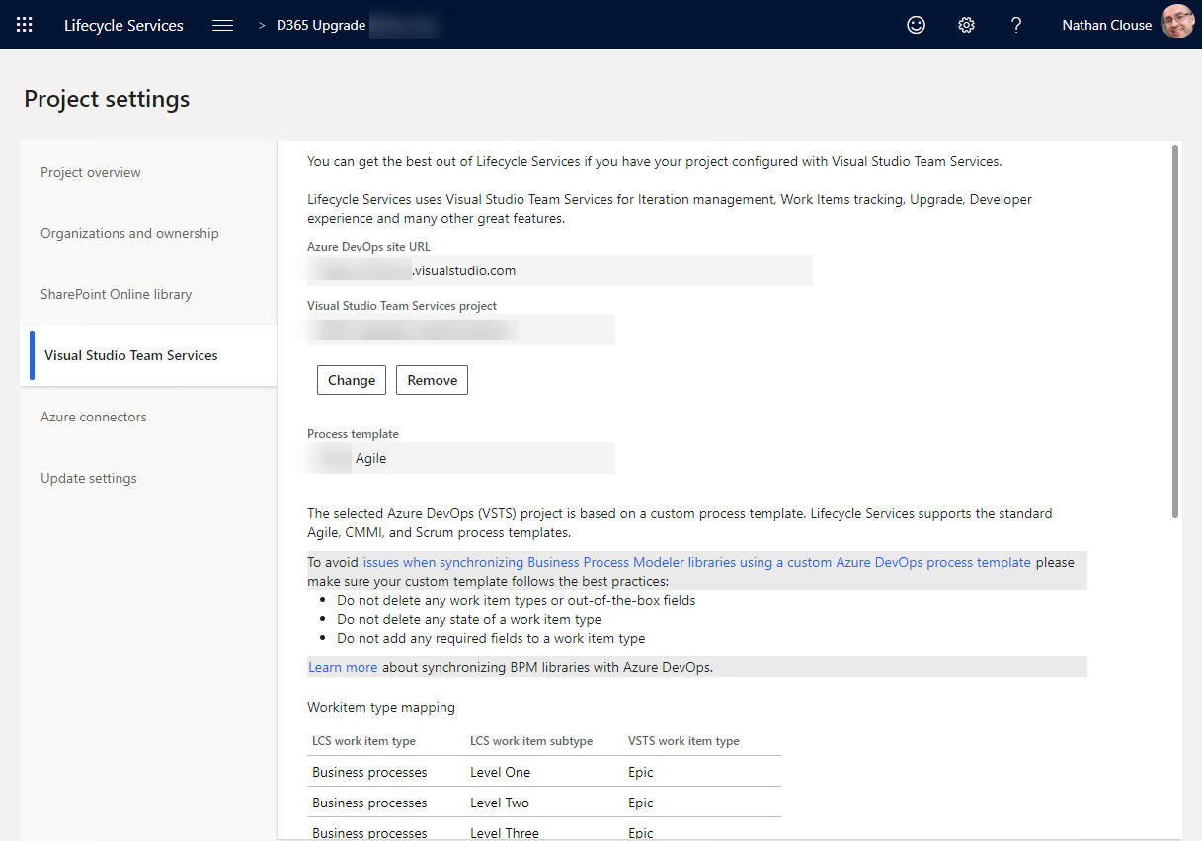
Project Settings – Azure DevOps (VSTS)

Slide 40
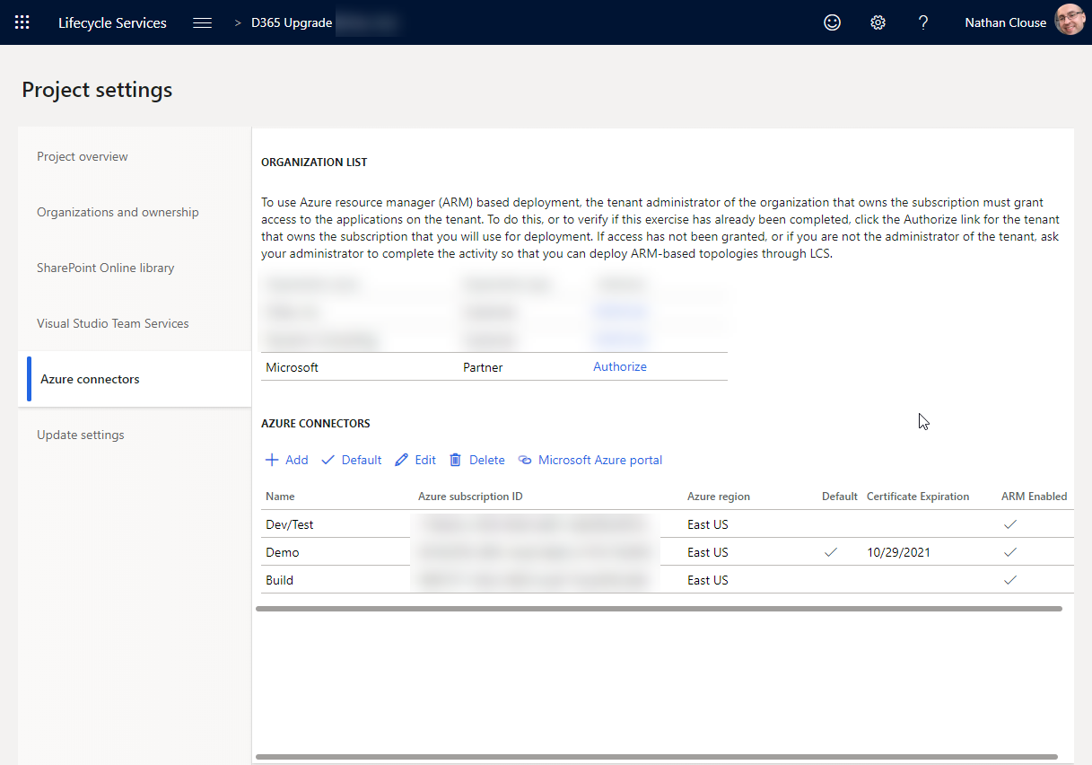
Project Settings – Azure Connections

Slide 41
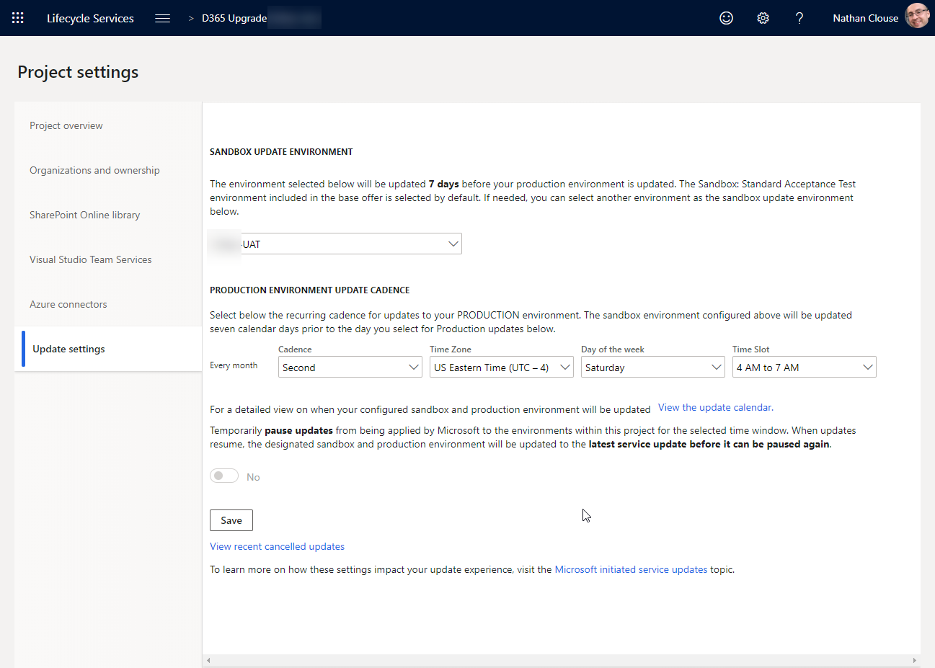
Project Settings – Update Settings

Slide 42
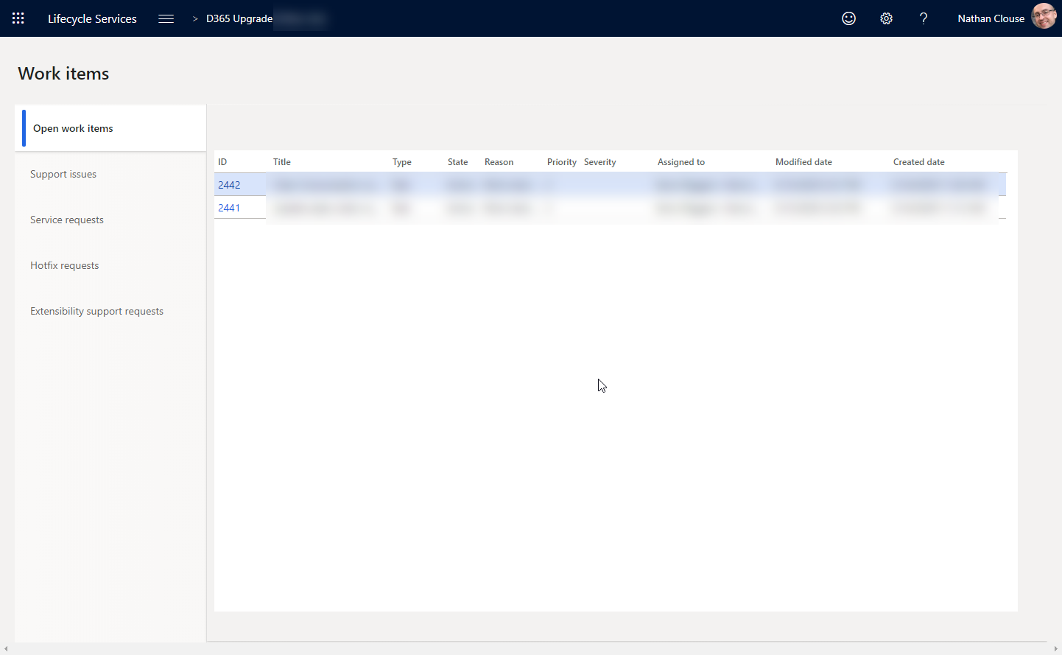
Work Items – Open Work Items

Slide 43
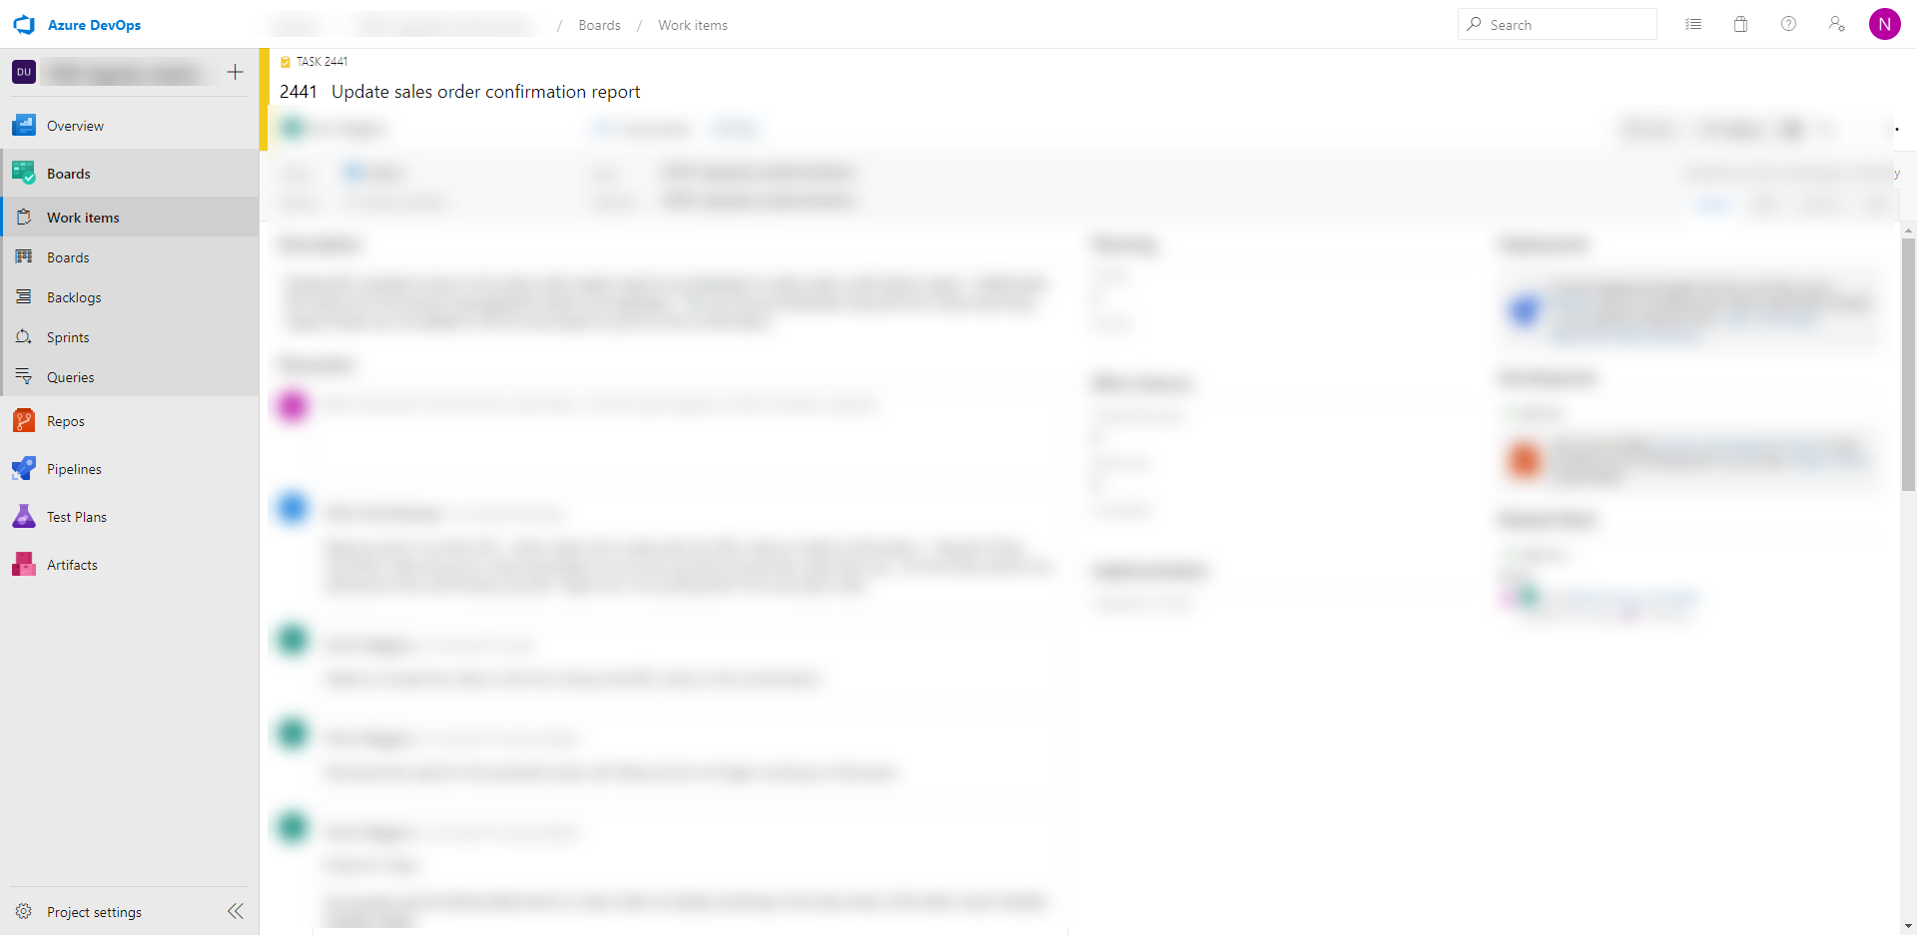
Work Items – Open Items (AZDO)

Slide 44
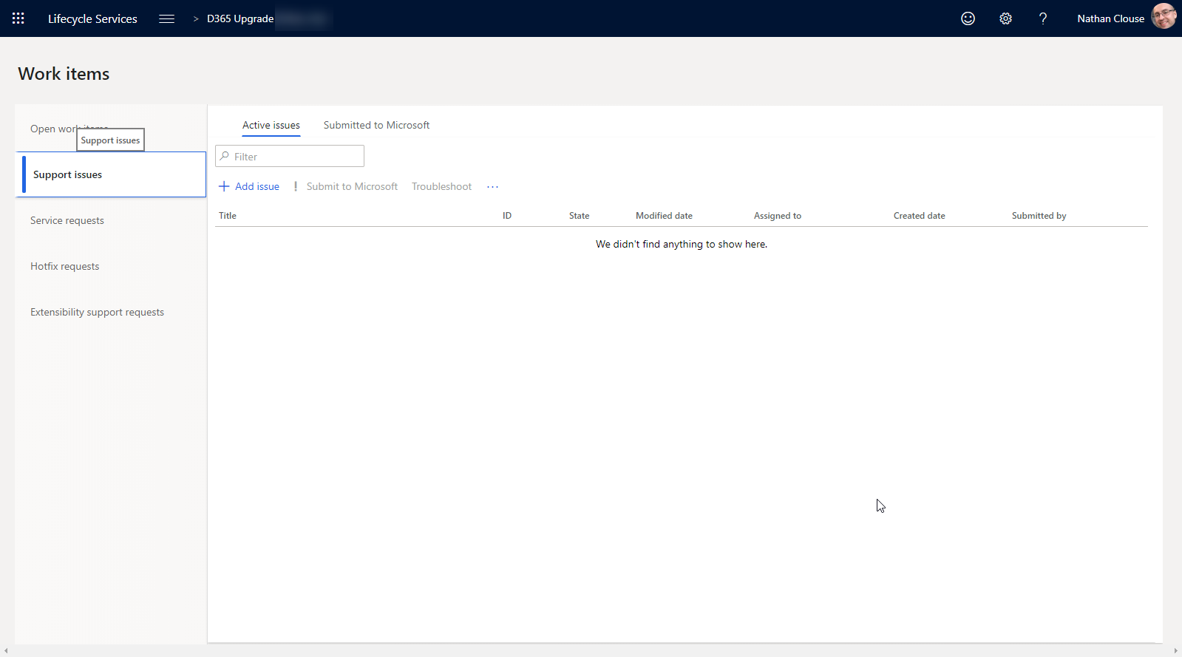
Work Items – Support Issues

Slide 45
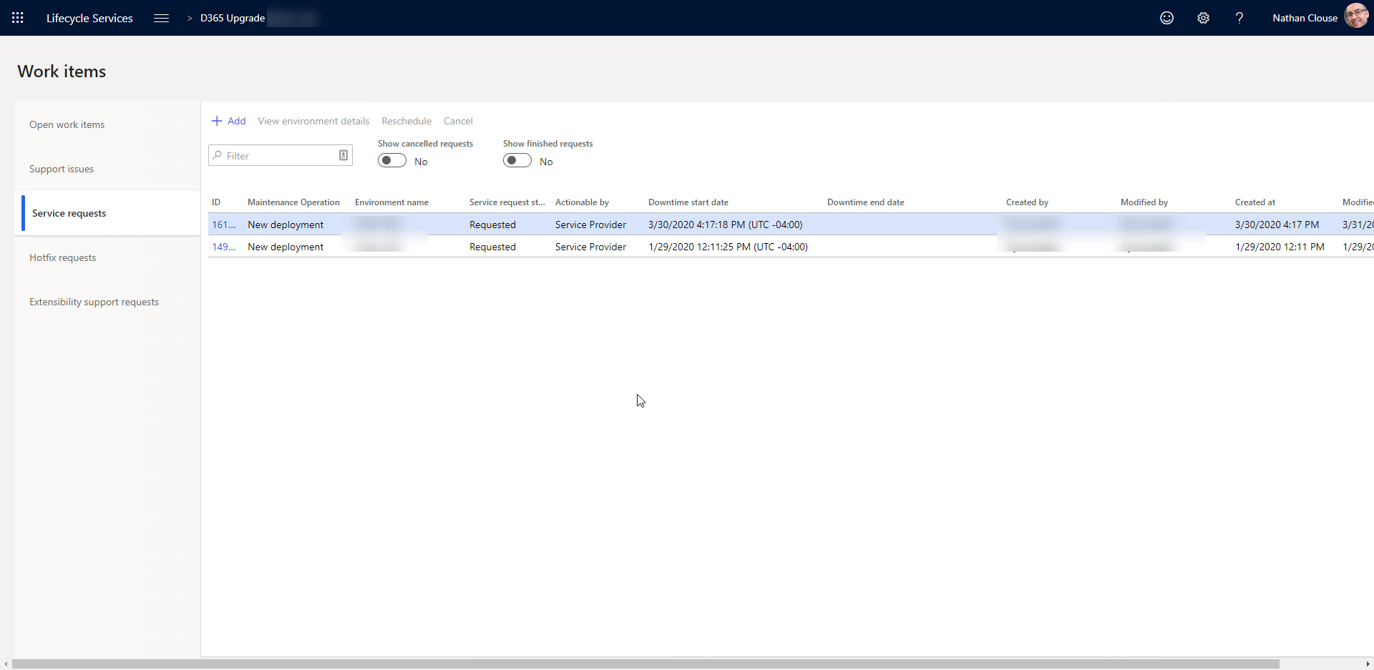
Work Items – Service Requests (DSE)

Slide 46
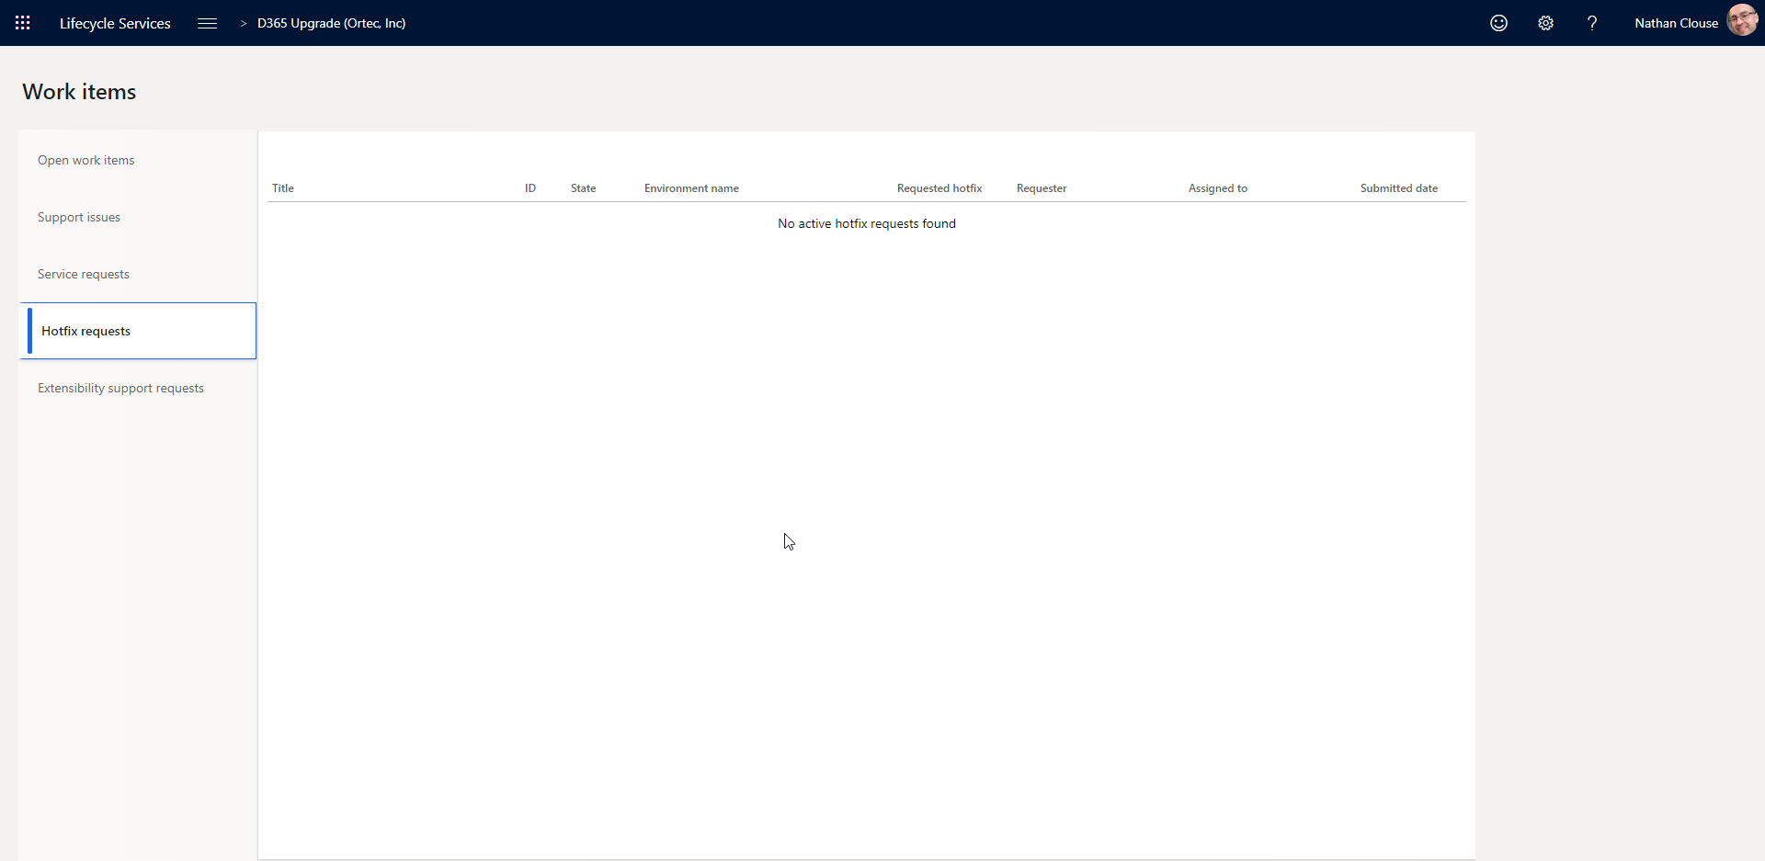
Work Items – Hotfix Requests

Slide 47
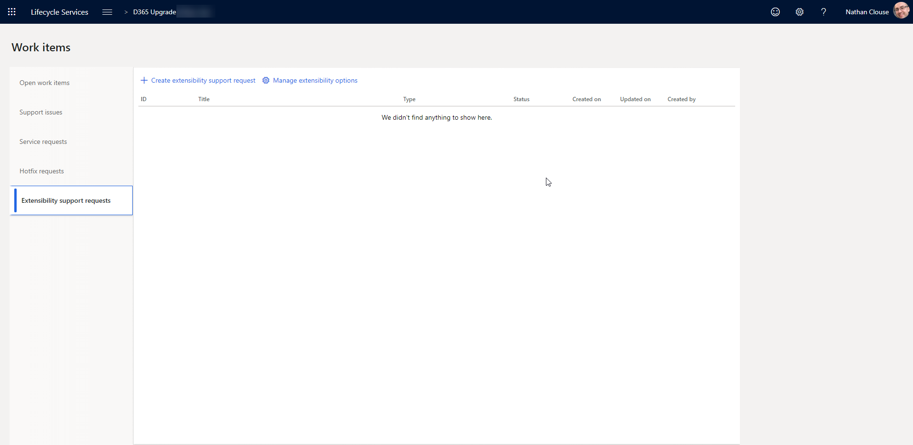
Work Items – Extensibility Support Requests

Slide 48
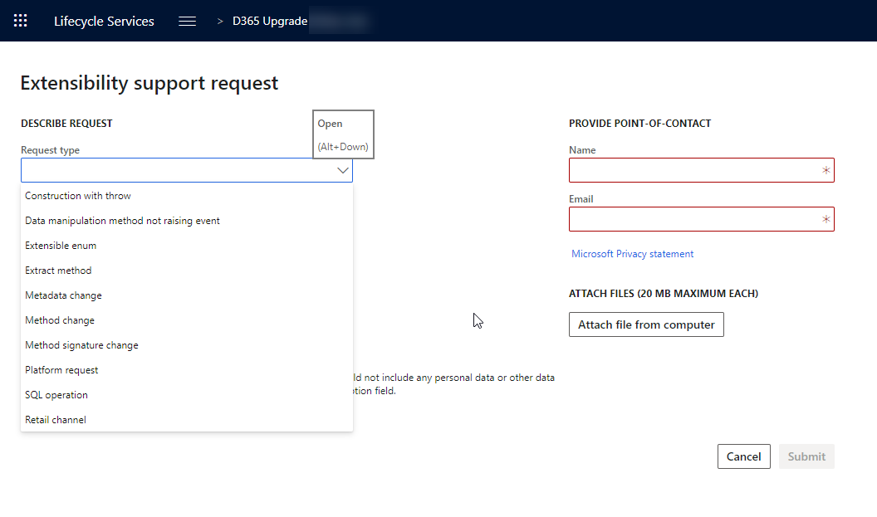
Work Items – Extensibility Support Requests

Slide 49

Topologies & Tiers

Slide 50

What is a topology?
Describes the composition of the environment
Develop
Build and Test
Standard Acceptance Test
Demo
Operations (Production)

Slide 51

What is an environment purpose?
Why it exists – what it is for
Development
System Test
UAT
Performance Test
Training
Operations

Slide 52
What is a tier?
Describe the scale or size of the environment
Tier 1 – 5
1 is the smallest
5 is the largest
Sizing to tier is relative and does not translate to exact number of specific with specific roles
I.e.; T5 could be 20 or 50 AOS servers
Sizing worksheet (Don’t forget it)
Notes:
who actually shot first? han solo

Slide 53

Tier Chart

Slide 54
What is an environment type?
Standard
This environment is included in the standard offer and is managed by Microsoft in a Microsoft subscription. Standard environments include the production environment, a Tier-2 Standard Acceptance Test environment, and one Tier-1 develop and test environment. No separate Azure billing.
Add-On
The add-on environments are in a Microsoft-managed subscription that the customer has purchased in addition to the standard offer. For example, an add-on environment might be an additional Tier-4 environment for performance testing. Additional SKU with no separate Azure bill.

Slide 55
What is an environment type? (cont.)
Cloud-Hosted
additional environments that are managed by the customer or partner in a customer or partner Microsoft Azure subscription. A cloud-hosted environment can include a Tier-1 demo environment. No additional SKU but has separate azure bill.
Environment Image (VHD)
additional Tier-1 environments are hosted on-premises by using a virtual hard disk (VHD) that can be downloaded from Microsoft Dynamics Lifecycle Services (LCS). Can be hosted locally on your laptop/desktop or your data center. Can be converted to other virtualization platforms and duplicated for multiple develops

Slide 56

Available Topologies
Develop for T1 “Onebox”
Build and Test for T1 “Onebox”
Sandbox for T2+
Operations for T2+
Notes:
what type of droid is R2D2 classified as? astromech droid

Slide 57

Major Tier Differences

Slide 58

Design Time vs Run Time
Design time
Has source code
Can develop here
Easy to debug
Runtime
Has binaries from code – compiled code
Cannot develop here but better performance
Can debug but not as easy – can be involved

Slide 59

Azure & Environments

Slide 60

The cloud costs money
Reduce waste
Size appropriately
Easy to over size to review periodically
Allocate machines to individuals
If for development, make them a contributor on that machine so they can manage its uptime
Use Tags in the Azure Portal

Slide 61
Schedule
Auto Shutdown
You can set auto shutdown times with email to webhook messages – send those to the assigned person
Start and Stop Scripts
Start and stop VMs are specific times
MSFT provides a tool to do this that requires some setup
Others have a free/paid service to help
Skyplug.io
VMPower.com

Slide 62

“Gotchas”
Shutdown does not mean no longer billing
Shutdown and deallocated means no longer billing
Managing availability and cost
Less about infrastructure
Notes:
THE MILLENNIUM FALCON, CAN COMFORTABLY FIT HOW MANY PEOPLE IN THE COCKPIT? Four

Slide 63
Provisioning

Slide 64
Provisioning
Orchestration of all environments, cloud or otherwise, is done though Life Cycle Services, or LCS.
https://lcs.dynamics.com
Use a generic account, like dynadmin@domain.com for management
Dynamics Service Engineer team commonly just called DSE.

Slide 65
By Type
Standard
Standard environments are managed via LCS. You create a request for the environment to be created which is then fulfilled and completed by DSE
Add-On
Same as standard after purchase and addition to LCS project.
Cloud Hosted
Entirely self-service.
On your Azure Subscription, LCS just orchestrates
All VMs created in a resource group for that VM
Can be on the same vNet if you want
Notes:
Standard
Standard environments are managed via LCS. You create a request for the environment to be created which is then fulfilled and completed by DSE (Dynamics Service Engineer) team commonly just called DSE.
Add-On
Same as standard after purchase and addition to LCS project.
Cloud-Hosted
Entirely self-service. Once you connect your LCS project to your Azure Subscription, you run through a wizard to create the VM and it submits the request to create that VM on your subscription with the specific options. If a new azure sub, request your core count be increase before provisioning your first VM. All VM resources are created in a resource group for that VM.

Slide 66
By Type (cont.)
VHD
Download from LCS. Go to hamburger > asset library > Downloadable VHD Files, import each part of the version you want, download each file individually, unpack, open in Hyper V.
Production / Operations
Submit a request to DSE with your subscription estimation worksheet complete. Request will be reviewed and approved. MSFT may request additional info or provide feedback on your request.

Slide 67
Servicing

Slide 68

Classic with VMs

Slide 69

Service Fabric (Without VMs)

Slide 70

Maintain

Slide 71
Operations
Apply Updates
This is where you can apply various deployable packages. These could be custom code, from an ISV or from Microsoft.
Messages Online users (VMs Only)
This will let you display a message to users who are active in the system. Typically, this is used to broadcast a system downtime message for people who are still active.
Upcoming Updates
Self-explanatory. You can see what is scheduled and when. If you wish to change the schedule, go to the hamburger > project settings > update settings

Slide 72

Apply Updates (Service Fabric)

Slide 73

Message Online Users (VMs Only)

Slide 74

Upcoming Updates

Slide 75
Operations (cont.)
Enable Access
This is where you will enable access to RDP to the various servers. This is an interface the change the firewall rules for the servers in that environment.
Restart Services
Here you’ll be able to start 1 of the following: Batch, DIXF, Reporting Server, LCS Diagnostics, IIS for VMs. Fewer for Service Fabric.
Move Databases
Several Options

Slide 76

Enable Access
Notes:
Only good for 8 hours
Only access to AQL

Slide 77

Enable Access
Notes:
Only good for 8 hours
Only access to AQL

Slide 78

Enable Access
Notes:
Only good for 8 hours
Only access to AQL

Slide 79

Restart Service (Service Fabric)

Slide 80

Restart Service (VMs)

Slide 81



Move Database

Slide 82
Operations – Move Databases
Refresh Database
A database refresh lets you copy the transactional and financial reporting databases of your production environment into the target, sandbox UAT environment. If you have another sandbox environment, you can also copy the databases from that environment to your target, sandbox UAT environment.
Import Database
Import a database into a standard environment from the asset library
Export Database
Export database from a standard environment to the asset library

Slide 83
Operations – Move Databases (cont.)
Point-in-Time restore Prod to Sandbox
allows you to restore to a sandbox user acceptance testing (UAT) environment from a backup of production not in the asset library.
Point-in-Time restore
Allows you to restore a database for the given environment from a backup for that environment that is not hosted in the asset library.

Slide 84
Operations (cont.)
Enable Maintenance Mode
Enabled maintenance mode for allow for specific configurations and processes to complete that may drastically alter the functionality of the system.
Upgrade (VMs Only)
Only applicable to 7.3 environments or lower, basically N/A at this point.
Rotate Secrets
Tier 1 only - this means to regenerate and assign new certificates for the instance.
Notes:
Enable Maintenance Mode
Enabled maintenance mode for allow for specific configurations and processes to complete that may drastically alter the functionality of the system. For instance, enabling account structures. Only enable on request and disable once complete.
Upgrade
Only applicable to 7.3 environments or lower, basically N/A at this point.
Rotate Secrets
Only applies to cloud hosted environments as the other types have their certificates managed by MSFT. This means to regenerate and assign new certificates for the instance.

Slide 85
Servicing by Type – Non-Prod
Standard / Add-on
Largely Self Service now
On MSFT’s Azure subscription
Can stop / deallocate if you wish for VMs
Cloud-Hosted
Similar to Standard / Add-on but reduced overall LCS functionality
Can stop / deallocate from LCS
VHD
Servicing is entirely manual via command line
Download from LCS update via scripts
Notes:
By Type
Standard and Add-On
Largely self service now. You can Deallocate and stop the environment if you wish. Standard environments are on MSFT’s subscription which is paid for by your licensing so there is no cost benefit to stopping environments. You can also apply updates, such as new code or updates from MSFT, message online users, view scheduled upcoming updated, if any, enabled RDP access by IP whitelist, restart various services, move databases, enabled maintenance and upgrade major version.
Cloud Hosted
Similar to standard but you can only apply updates, message online users and also rotate secrets
VHD
Servicing is all manual doing via command line. Code is installed manually and/or synced from Azure DevOps. Platform Updates are downloaded locally and installed via command line. Community module available to assist with this if needed – D365 Tools.

Slide 86
Servicing by Type - Prod
Production / Operations
All actions available as service requests
Fulfilled by DSE
Most commonly you would request a code deploy or a database operation

Slide 87

Servicing by Type – Prod (cont.)
Notes:
https://docs.microsoft.com/en-us/dynamics365/unified-operations/dev-itpro/lifecycle-services/submit-request-dynamics-service-engineering-team#service-request-types-and-slas

Slide 88

Servicing by Type – Prod (cont.)

Slide 89

Tear Down: Non-Prod
Cloud-Hosted
Deallocate then delete. All data are lost and all resources in VM resource group are deleted including resource group
Standard / Add-On
Deallocate then delete. Can re-provision once delete is complete. Slot remains if unused

Slide 90


Teardown: Production
Nope
Entirely Managed by MSFT

Slide 91

Resizing
Cloud-Hosted
Resize the VM
LCS may not reflect the state of the VM
Standard / Add-On
For non-production, delete and re-provision
For Prod, create a request to re-evaluate usage based on licenses, increased functionality or seasonality
Notes:
What does AT-AT stand for? All Terrain Armored Transport.

Slide 92
Tools

Slide 93

Business Process Modeler (BPM)
Notes:
You can perform fit-gap analysis between your business requirements and the default processes in the Finance and Operations apps.

Slide 94
BPM Sync

Slide 95

BPM Library

Slide 96

VSTS (Azure DevOps) Sync
Notes:
Regression Suite Automation Tool

Slide 97

Upload Task Recording

Slide 98

Diagrams

Slide 99
Analytics, Diagnostics and Environment Monitoring

Slide 100


Slide 101


Slide 102

Where to Find It - PROD

Slide 103

Where to Find It - UAT

Slide 104

System Diagnostics
Available in UAT / Sandbox environments plus PROD
Reports Server info
Failed jobs
Detected issues
High level overview of an environment

Slide 105

Environment Monitoring
Available in Prod and UAT only
High Scale, low latency
“hot path”
What’s going on right now
User Interaction
User load
Activity Load
SQL Insights
Review SQL level activity
Rebuild / create indexes
Review load and usage
Notes:
The User interaction chart shows a user's activities on various machines in the environment and the SQL utilization trend.
The User load section shows all the system users. Each chart shows the time that the user spent on a specific machine.
The Activity load section shows the activities that were performed on each machine. If you hover over an activity, you see the Form:Control:Action as a tuple. For example, if you look at LedgerJournal:New:Click in this section, you can see that user A opened the LedgerJournals page and selected the New button to create a new journal entry.
The User activity grid shows the various activities that users performed, based on their session timestamp.

Slide 106

Overview – 10 PM Friday Night

Slide 107

Overview – 10 AM Monday Morning

Slide 108

Index Analysis

Slide 109

Index Analysis - Details
Notes:
Seeks up, updates up, row counters fluctuation, index size fluctuation

Slide 110

Performance Metrics

Slide 111

Performance Metrics - Again
Notes:
Changed date/time range, got different results to review, look at timing to see outliers

Slide 112


(SQL) Actions

Slide 113


Queries

Slide 114

Queries - Fragmentation
Notes:
Sorted by table name

Slide 115

Queries – Fragmentation
Notes:
Sort by fragmentation

Slide 116

Health Metrics

Slide 117


Activity

Slide 118

Questions?

Slide 119


